Slide 1
Master Project Seminar WS 25/26
Shang-Ching Liu

Slide 2
Presentation Schedule
Date | Presenter Name | Session-Chair Name
20 Nov 2025 | T1: T2:
27 Nov 2025 | T1: Sabeeh ur Rehman T2: Jonas
4 Dec 2025 | T1: Felix T2: Nhat Minh Phuong
11 Dec 2025 | T1: T2:
8 Jan 2025
15 Jan 2025
22 Jan 2025
29 Jan 2025
Application Level Discussion
Method Level Discussion

Slide 3
Presentation - Requirement
Each presentation is to be held by a single student.
Presentation language is English.
You are free too chose any tools to use to create your slides.
If you chose LaTeX you can use this template for the presentation.
The presentation shall be PRACTICED MULTIPLE TIMES before presenting. Your audiences will know whether you did or not.
This is also helpful to check if you keep in time.
You're welcome to discuss your presentation with us before presenting.
Here, here and here are some good examples slide sets from previous years or here for last semester.
Try to get the viewers attention by giving a good motivation in the beginning ("Why should the viewer care about this topic?", "Why is this interesting?").
Have some extra slides prepared after your presentation that you can use to answer questions.
Try not to use too much text on the slides. Rather use a lot of images.
Not everything you say should be on the slides. They are a visual aid for your listeners.

Slide 4
Presentation - Hint
The presentation must include the following things:
A title page with the title, your name and the date of presentation
All slides should be numbered for easier reference in the following discussion
An introduction to the topic, necessary definitions and maybe a short introduction to its basics and history
A clear definition of the problem to be solved
Presentation of the approaches
Presentation of the results
Discussion of advantages and disadvantages of the presented approach(es) and its/their results
A comparison of the approaches (Method Level)
All images/graphics which are not your Intellectual property must be referenced
You must submit your final set of slides (which you used for presentation) after presentation

Slide 5
Presentation - Grading
The presentation will be graded according to:
Amount of contained information and precision of your explanations
Comprehensibility of your presentation and its slides
Liveliness of your presentation
Quality of your answers during discussion
Adherence to requirements listed above and to the time limit
Presentation
25 minutes presentation. Being much shorter will decrease your grade or even lead to failing. We will warn you when time runs out and stop you after 25 min
Moderate discussion afterwards
You might discuss the topic with me 14 days before your presentation.
You must hand in your draft slides by noon 7 days before your presentation through e-mail: shang-ching.liu@uni-hamburg.de.
Final slide must be sent to me 1 day after your presentation the latest.

Slide 6
Topic Choosing

Slide 7
Requirement
Right scope - Example: "Kinematics" is too broad, "Actuating a Servo" is too narrow
Right depth - Example: "Comparison of Resolution of Video Sensors" is too shallow, "The Effect of Color Depth of the Logitech C920 on Recognizing Grass" is too deep
Scholarly standard - There is no "too scientific" but your topic has to be in recent active research
Robotics - Your topic has to be useable/applicable/required on/in/for physical robots
Intelligent - Example: "Manufacturing a Car" is not intelligent, "Analyzing, Understanding and Repairing a Broken Down Car" can be intelligent
Recency - Your main references should be recent (published in the last 5 years)
Please send your Topic Proposal 05.12.25 11:59PM by email (shang-ching.liu@uni-hamburg.de) to submit a description of your topic with at least 2 scientific references which you plan to talk about
You can have a look at the topic list for inspiration, but you're very welcome to come up with your own ideas! Your idea must be robotics related and may be rejected if it does not fit the seminar.

Slide 8
First Step to Find Your Research Topic:
Identify Your Area of Interest
Reflect on fields or topics that genuinely intrigue you.
Explore Prominent Conference Keynotes
Example: Review keynote presentations from major conferences such as ICRA Keynotes.
Dive into Conference Proceedings
Example: Access the video list from ICRA proceedings here: /informatik2/tams/internal/proceeding/icra/2024
Search by Keywords
Choose a relevant topic from the conference or research field.
Use keywords for targeted searches. Examples:
"Motion Planning Survey"
"Leveraging ChatGPT and LLMs for Research Assistance" (Note: Verify generated information thoroughly.)

Slide 9

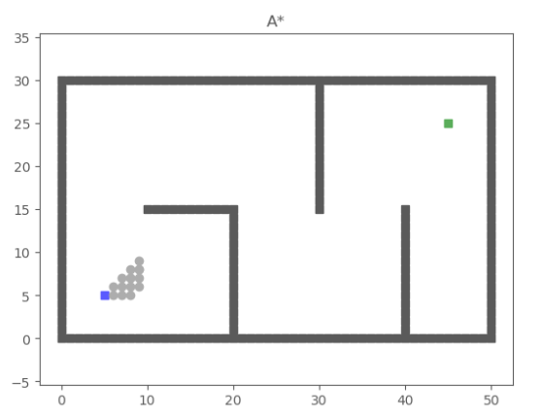
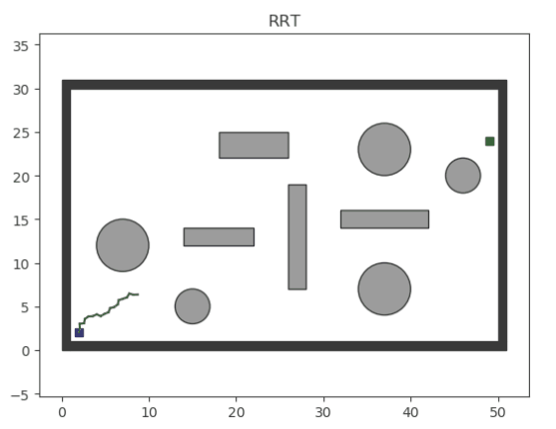
Localization and Path Planning
SLAM (Simultaneous localization and mapping)
Path Planning Algorithm
https://en.wikipedia.org/wiki/Simultaneous_localization_and_mapping
https://github.com/zhm-real/PathPlanning

Slide 10
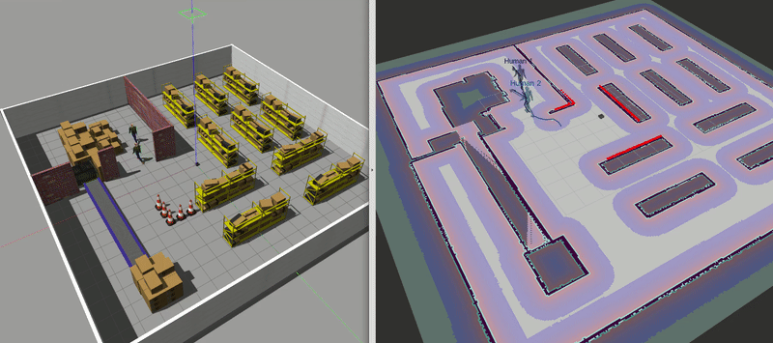
Motion Planning
https://github.com/ai-winter/ros_motion_planning

Slide 11
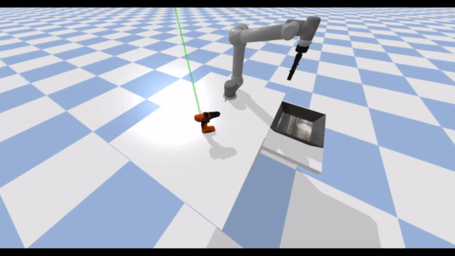
Grasping
https://github.com/JeroenOudeVrielink/ur5-robotic-grasping

Slide 12
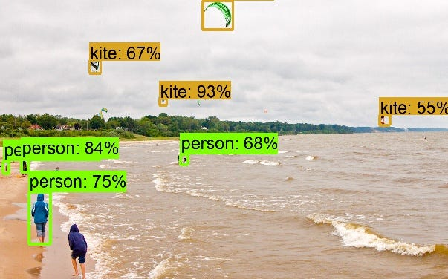
Object Recognition
https://github.com/CapstoneProject18/Object-Recognition

Slide 13
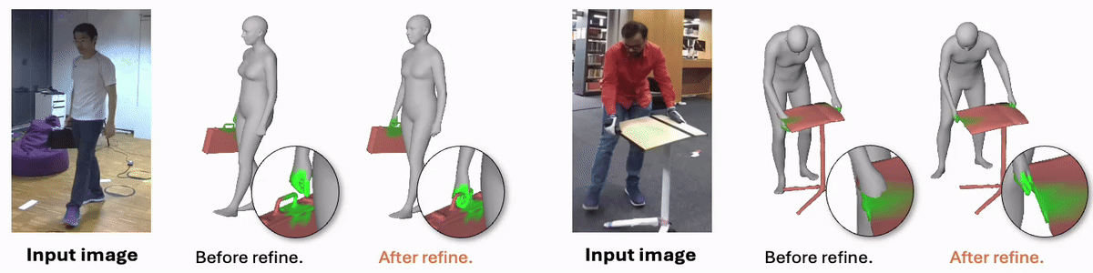
Object Reconstruction
https://github.com/dqj5182/CONTHO_RELEASE

Slide 14
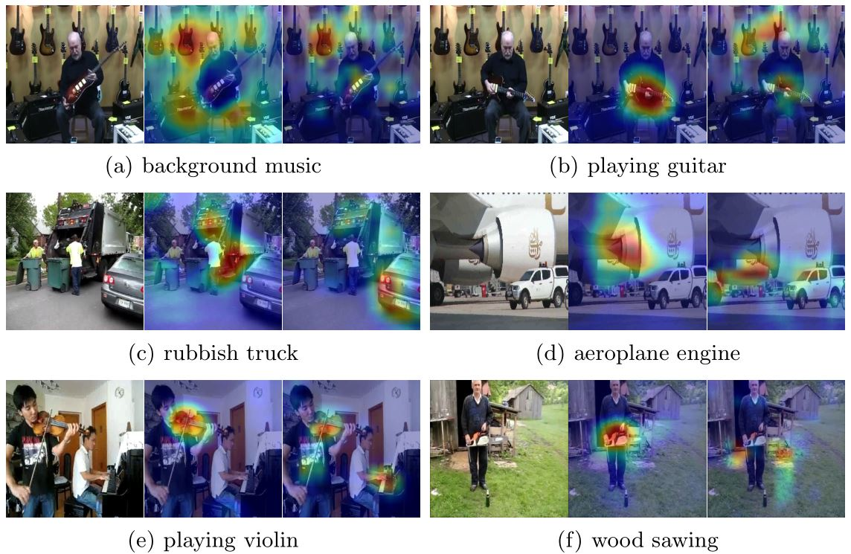
Sound Localization and Recognition
https://github.com/shvdiwnkozbw/Multi-Source-Sound-Localization

Slide 15
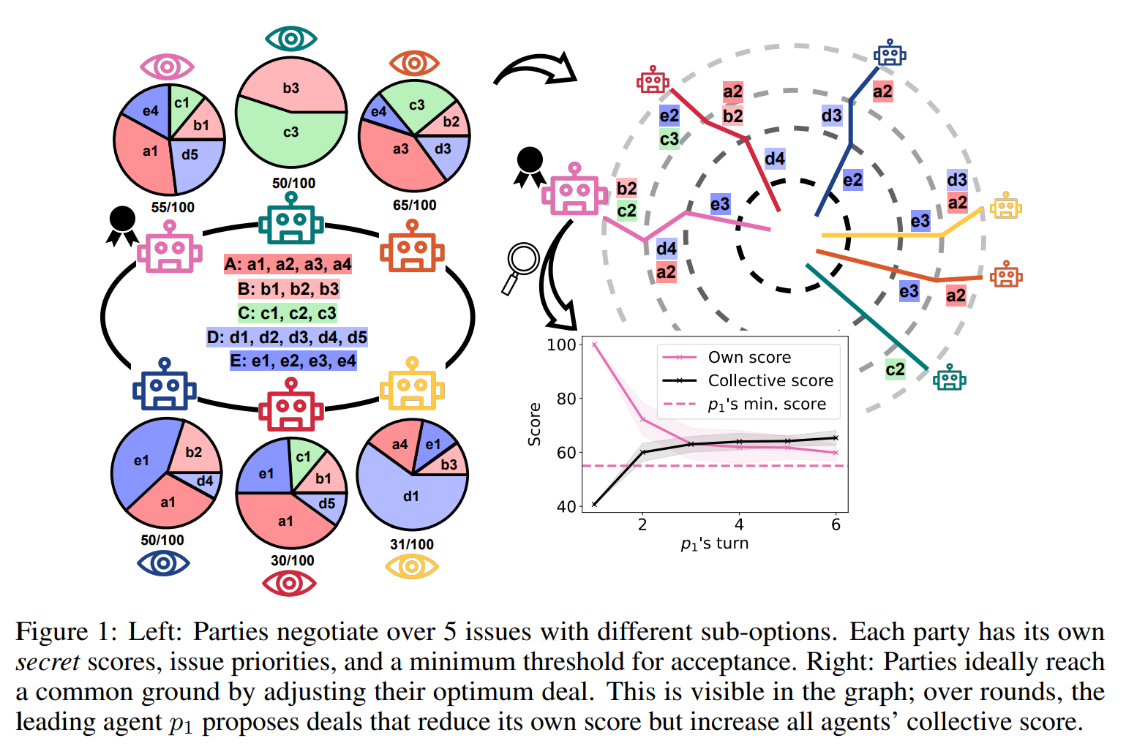
Robot action deliberation
State Machine
Behavior Tree
LLM based approach
https://github.com/S-Abdelnabi/LLM-Deliberation

Slide 16
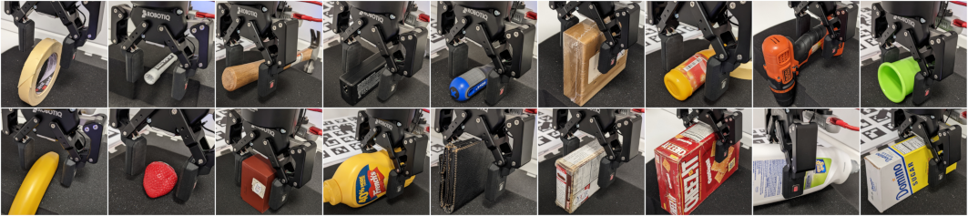
Force Control
https://github.com/hsp-iit/adaptive-tactile-force-control

Slide 17
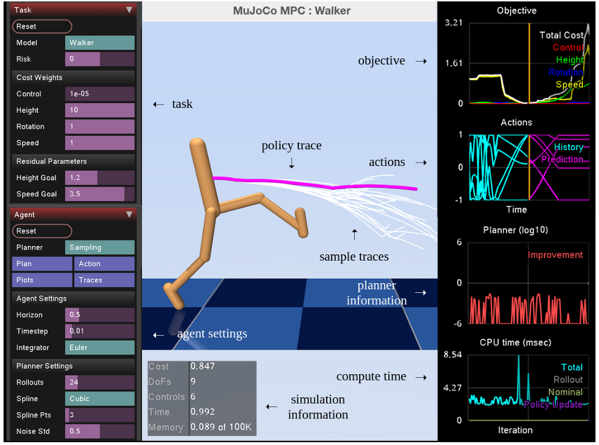
Optimal Control / Model Predictive Control (MPC)
DeepMind (2022). Predictive sampling: Real-time behaviour synthesis with mujoco

Slide 18
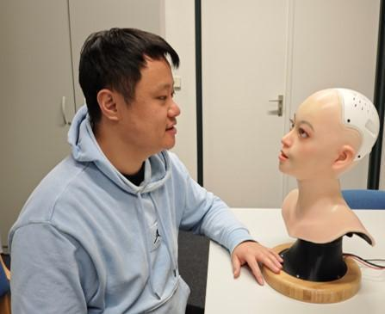
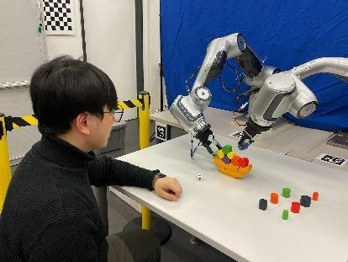
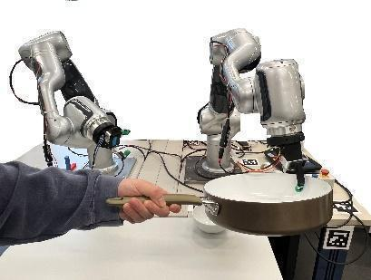
Human-Robot Interaction

