Slide 1
EEG-based Motor Imagery Classification with Tuned Heuristic Fusion Graph Convolutional Network in Spinal Cord Injury Rehabilitation
Kecheng Shi
June 11, 2023

Slide 2
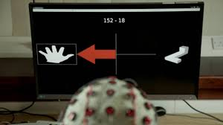
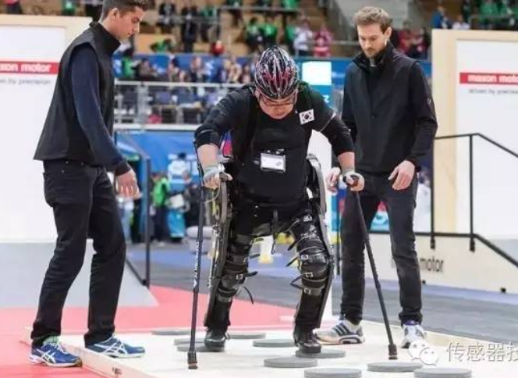
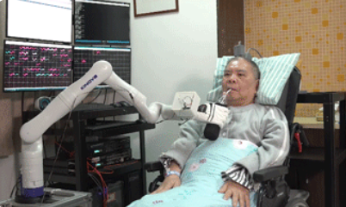
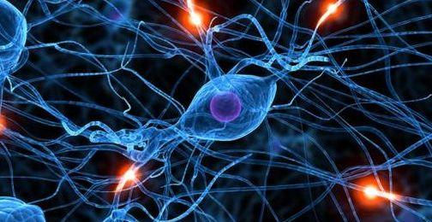
Research objective: MI-BCI for spinal cord injury patients
Spinal cord injury leads to the motor and sensory dysfunction of patients’ limbs, and seriously affects the quality of patients’ life. The functional recovery of patients has always been a rehabilitation problem.
MI-BCI
×
Motor Function ⬇ ⬇
Sensory Function ⬇ ⬇
Neural Remodeling

Slide 3

In MI-BCI, the main research point is the MI-EEG classification method. The primary objectives include achieving the precise prediction of limb movements for individual patients (within-patient) and ensuring consistent predictive reliability across different patients (cross-patient).
within-patient case:
cross-patient case:
√
Training
EEG data
A
Training
Testing
A
B
C
G
…
EEG data
Testing
Training
Testing
√
EEG data
H
√
EEG data
B

Slide 4
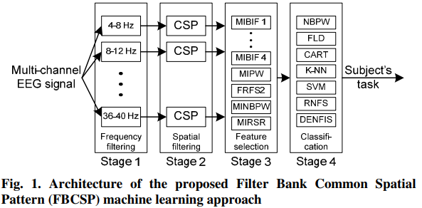
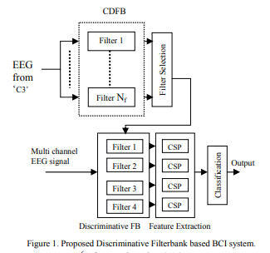
Machine learning based MI-EEG classification methods
[1] Ang K K, et al. IEEE International Joint Conference on Neural Networks. 2008.
[2] Thomas K P, Guan C, et al. IEEE International Symposium on Circuits and Systems. 2009.
Notes:
However, hand-crafted features can often only extract shallow features and ignore the critical ones contained in the EEG signal, which causes the performance of machine learning methods not to meet the needs of practical applications.

Slide 5
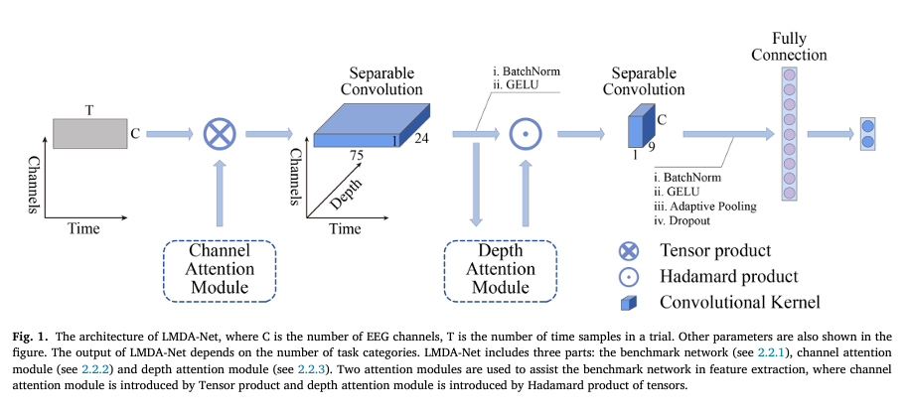
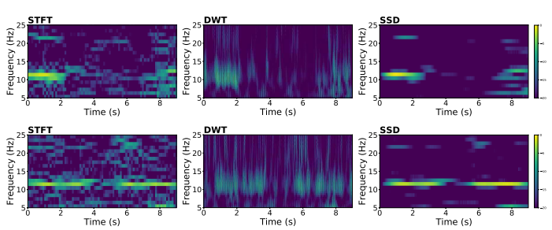
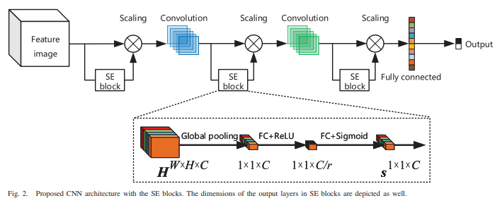
Deeping learning based MI-EEG classification methods
[1] Miao Z, et al. NeuroImage, 2023.
[2] Sun B, et al. IEEE Transactions on Automation Science and Engineering, 2020.

Slide 6
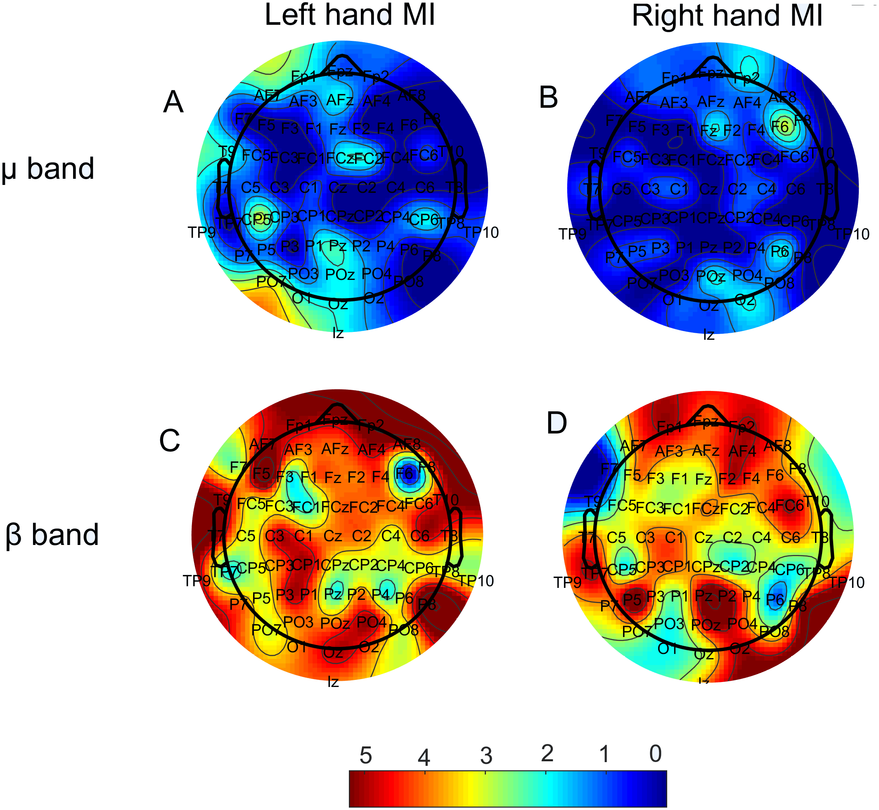
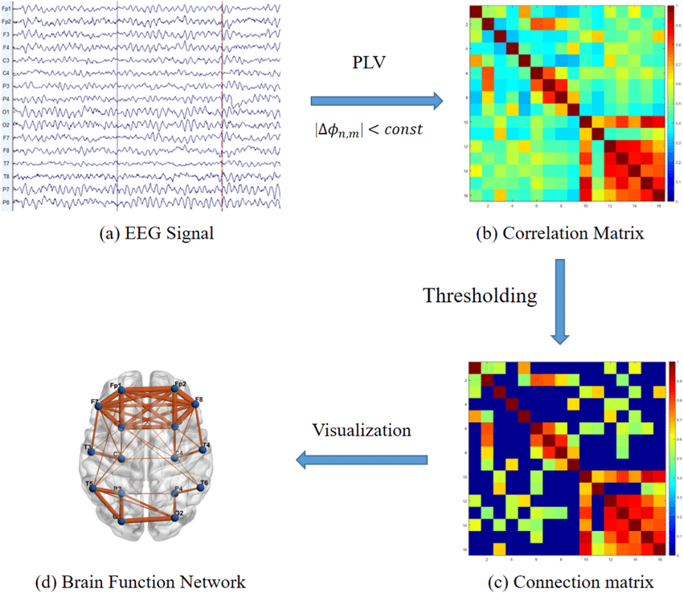
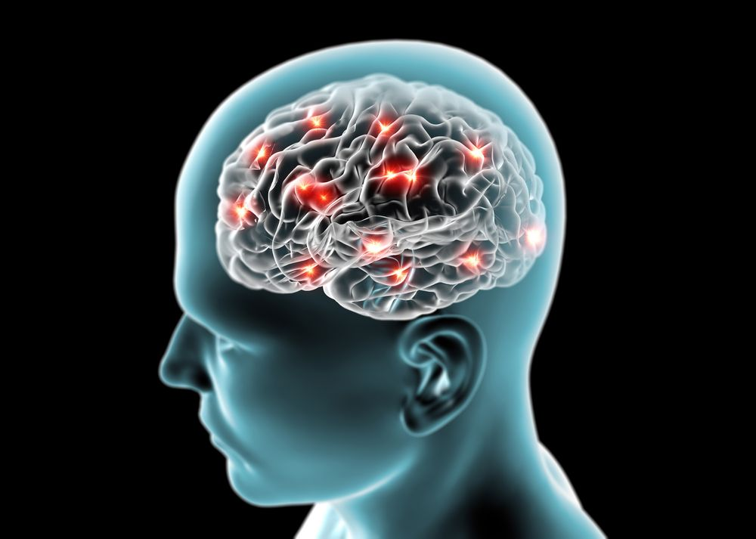
Deeping learning methods based MI-EEG classification methods
[1] Ke P, Xiong D, Li J, et al. An integrated machine learning framework for a discriminative analysis of schizophrenia using multi-biological data[J]. Scientific reports, 2021, 11(1): 14636.
Notes:
But in the course of MI processing, activation and communication occur simultaneously among different brain regions. And this non-Euclidean structural property is hard capture by convolutional neural networks relying on Euclidean distance metrics.

Slide 7
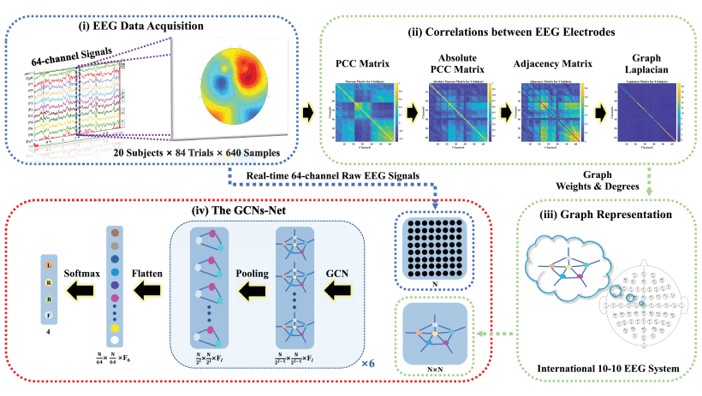
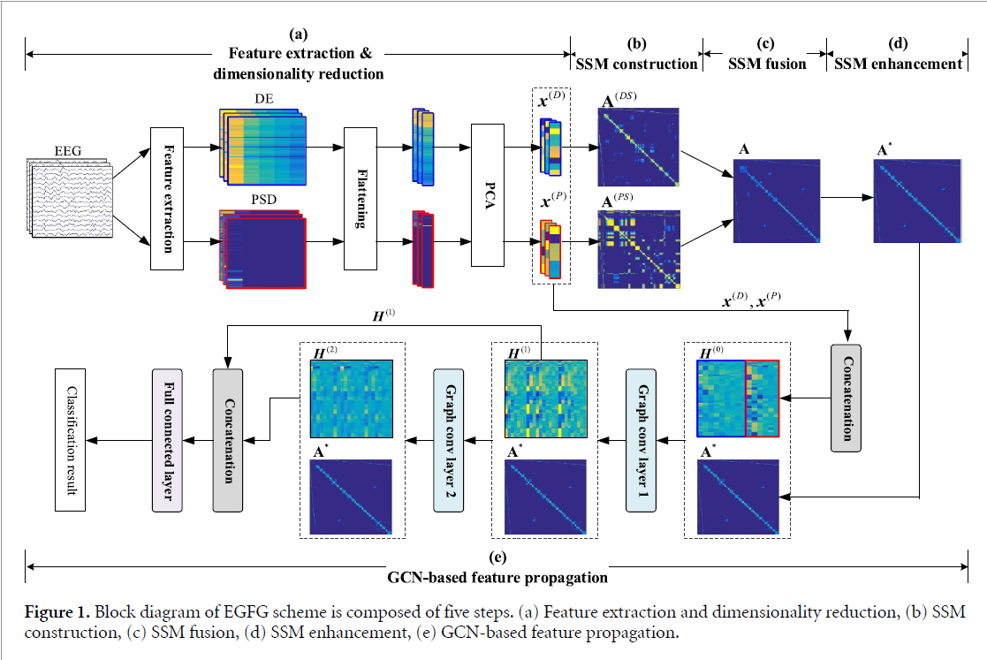
Deeping learning methods based MI-EEG classification methods
[1] Hou Y, Jia S, Lun X, et al. IEEE Transactions on Neural Networks and Learning Systems, 2022.
[1] Li G, Chen N, Jin J. Journal of Neural Engineering, 2022.

Slide 8
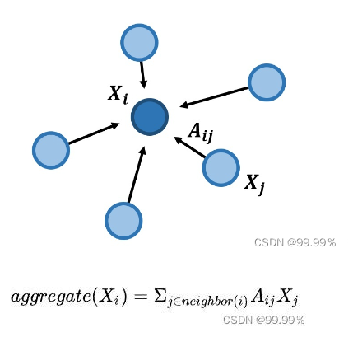
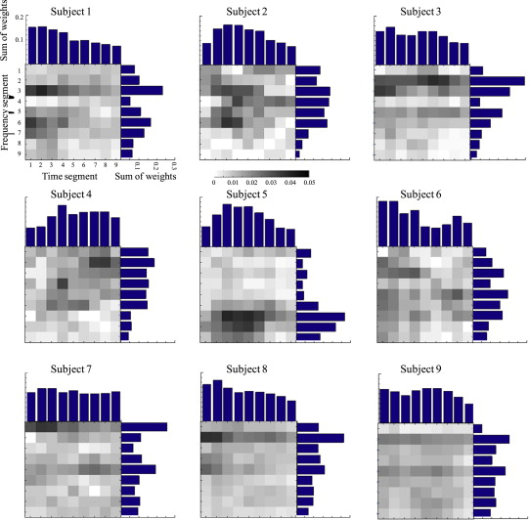
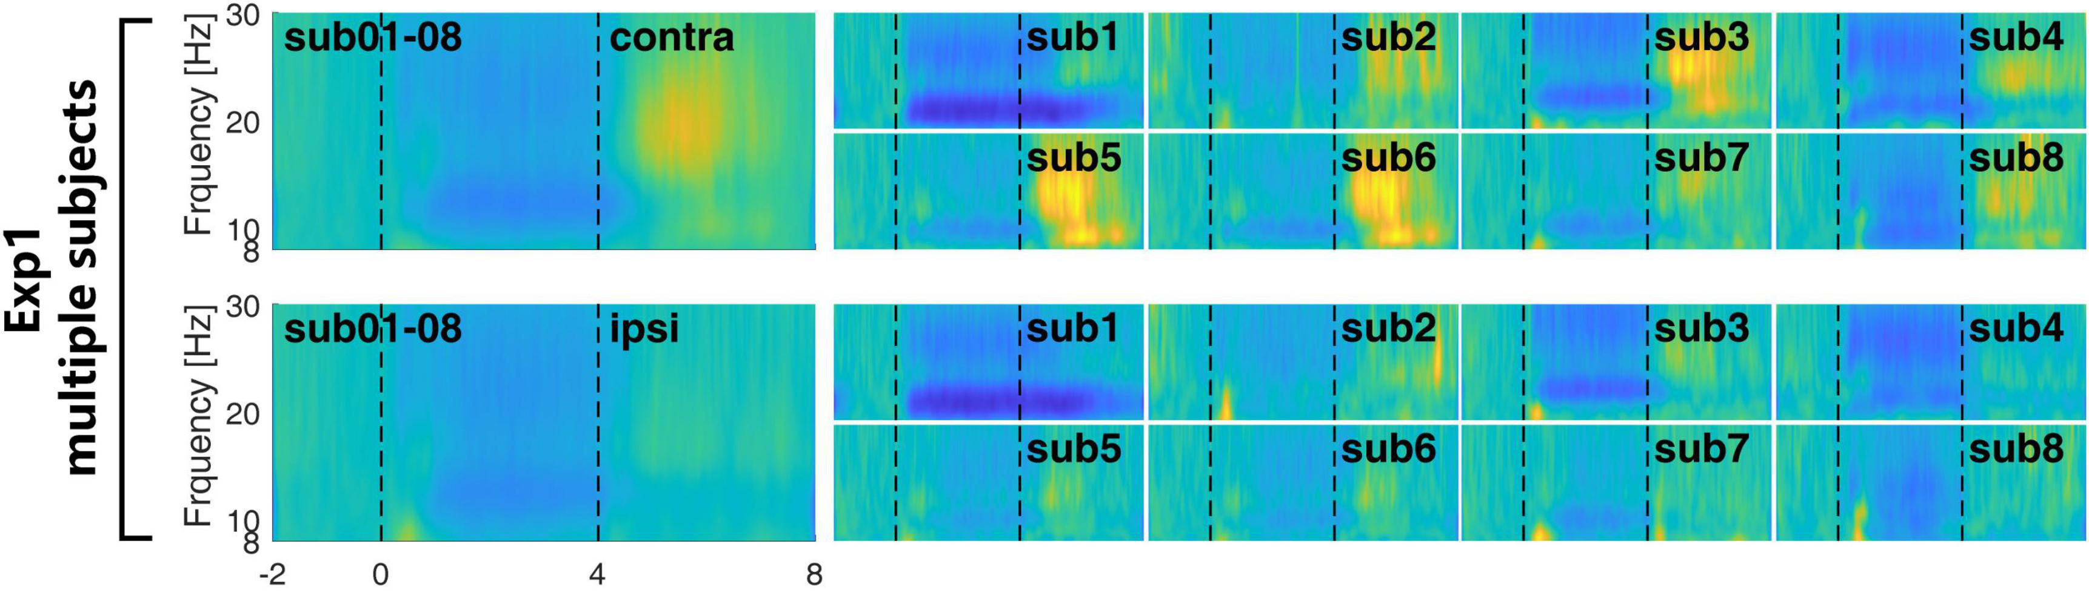
GCNs require a pre-given adjacency matrix, the matrix is a representation of the graph topological connectivity and determines how features are combined between different graph nodes.
Recent works have constructed the adjacency matrix using the sub-frequency band data channel or feature channel correlation coefficients, and ignored that MI response frequencies and brain activation patterns are less consistent across subjects, which makes the GCNs-based BCI difficult to generalize to new subjects.
[1] Huang G, Zhao Z, Zhang S, et al. Frontiers in Neuroscience, 2023.
[2] Kam T E, Suk H I, Lee S W. Neurocomputing, 2013.
Notes:
It shows the weights of each frequency band for different patients when performing motor imagery. It shows the weights of each frequency band for different patients when performing motor imagery.

Slide 9
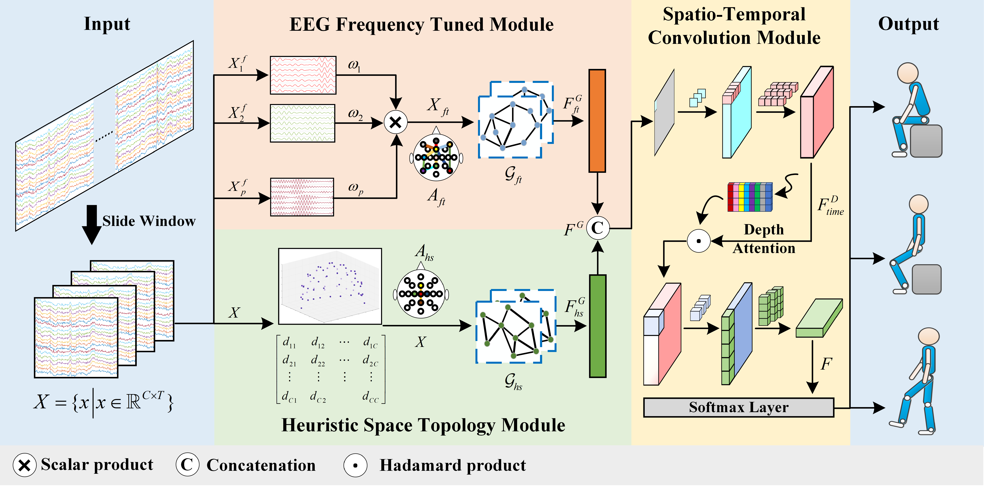
Tuned Heuristic Fusion Graph Convolutional Network
EFTM: filters the MI response band from various EEG sub-frequency band data, subsequently extracting the tuned frequency topological features.
HSTM: establishes the adjacency matrix based on the spatial distances of EEG channels. Then, extracts the shared spatial topological features among different subjects.
STCM: integrates the topological features obtained from the EFTM and HSTM modules and extracts the temporal and spatial characteristics.
Notes:
Considering that motor imagery response frequencies vary greatly from patient to patient, we propose an EFTM module, which first decomposes the EEG raw signal into multiple sub-band signals, and then learns and filters the MI response bands of different patients using a learnable weighting layer. Finally, we use GCN to extract the modulation frequency topological features of the response band data.
To enhance the generalisation ability of the designed method to new subjects, we consider that each patient has the same spatial structure of the brain, and we use this information as a heuristic to construct the adjacency matrix, followed by a two-layered GCN framework to extract spatial topological features in the EEG raw data.
Finally, we combine the obtained topological features and use a temporal separable convolution and a spatial separable convolution to further extract temporal and spatial features in the EEG signals.Meanwhile, I believe that the temporal features are more important for motor imagery, and we propose a deep-attention mechanism to let our network focus on the important temporal features.

Slide 10
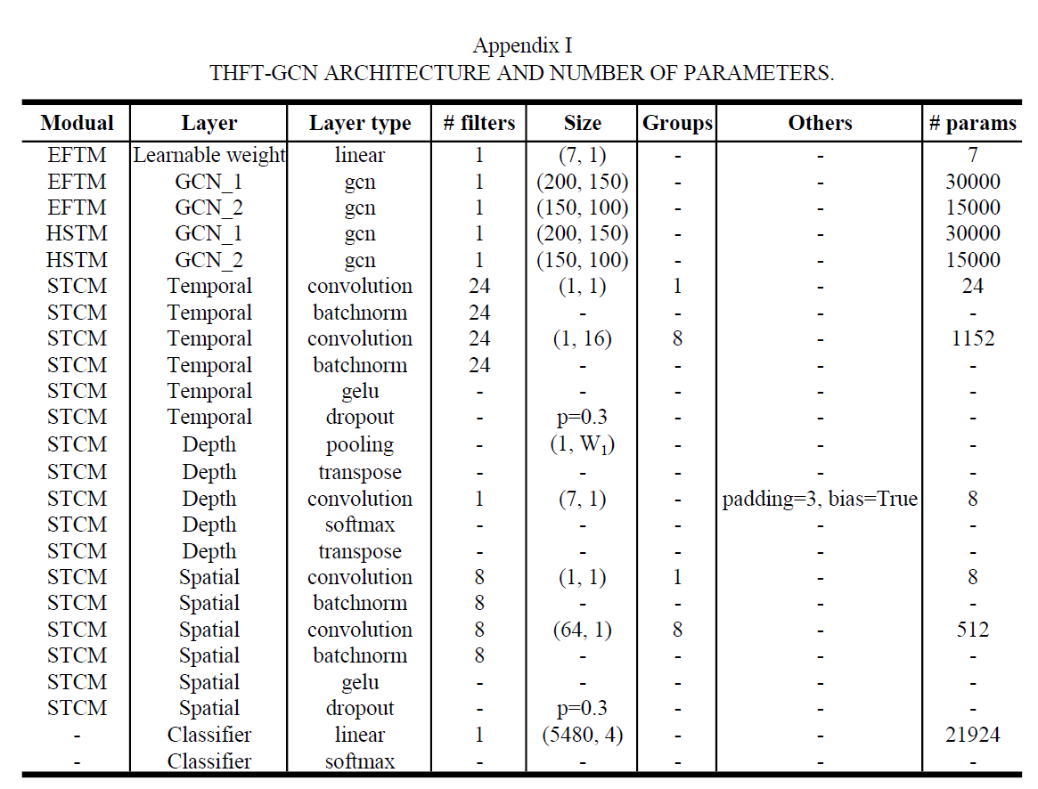
Model Parameter

Slide 11
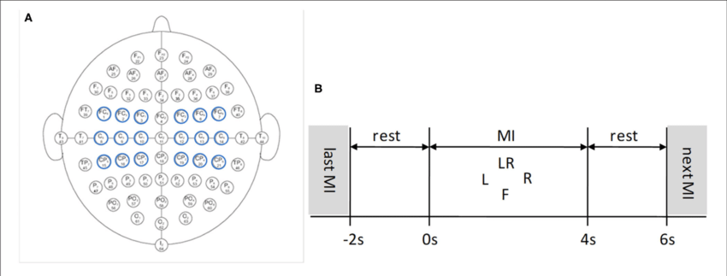
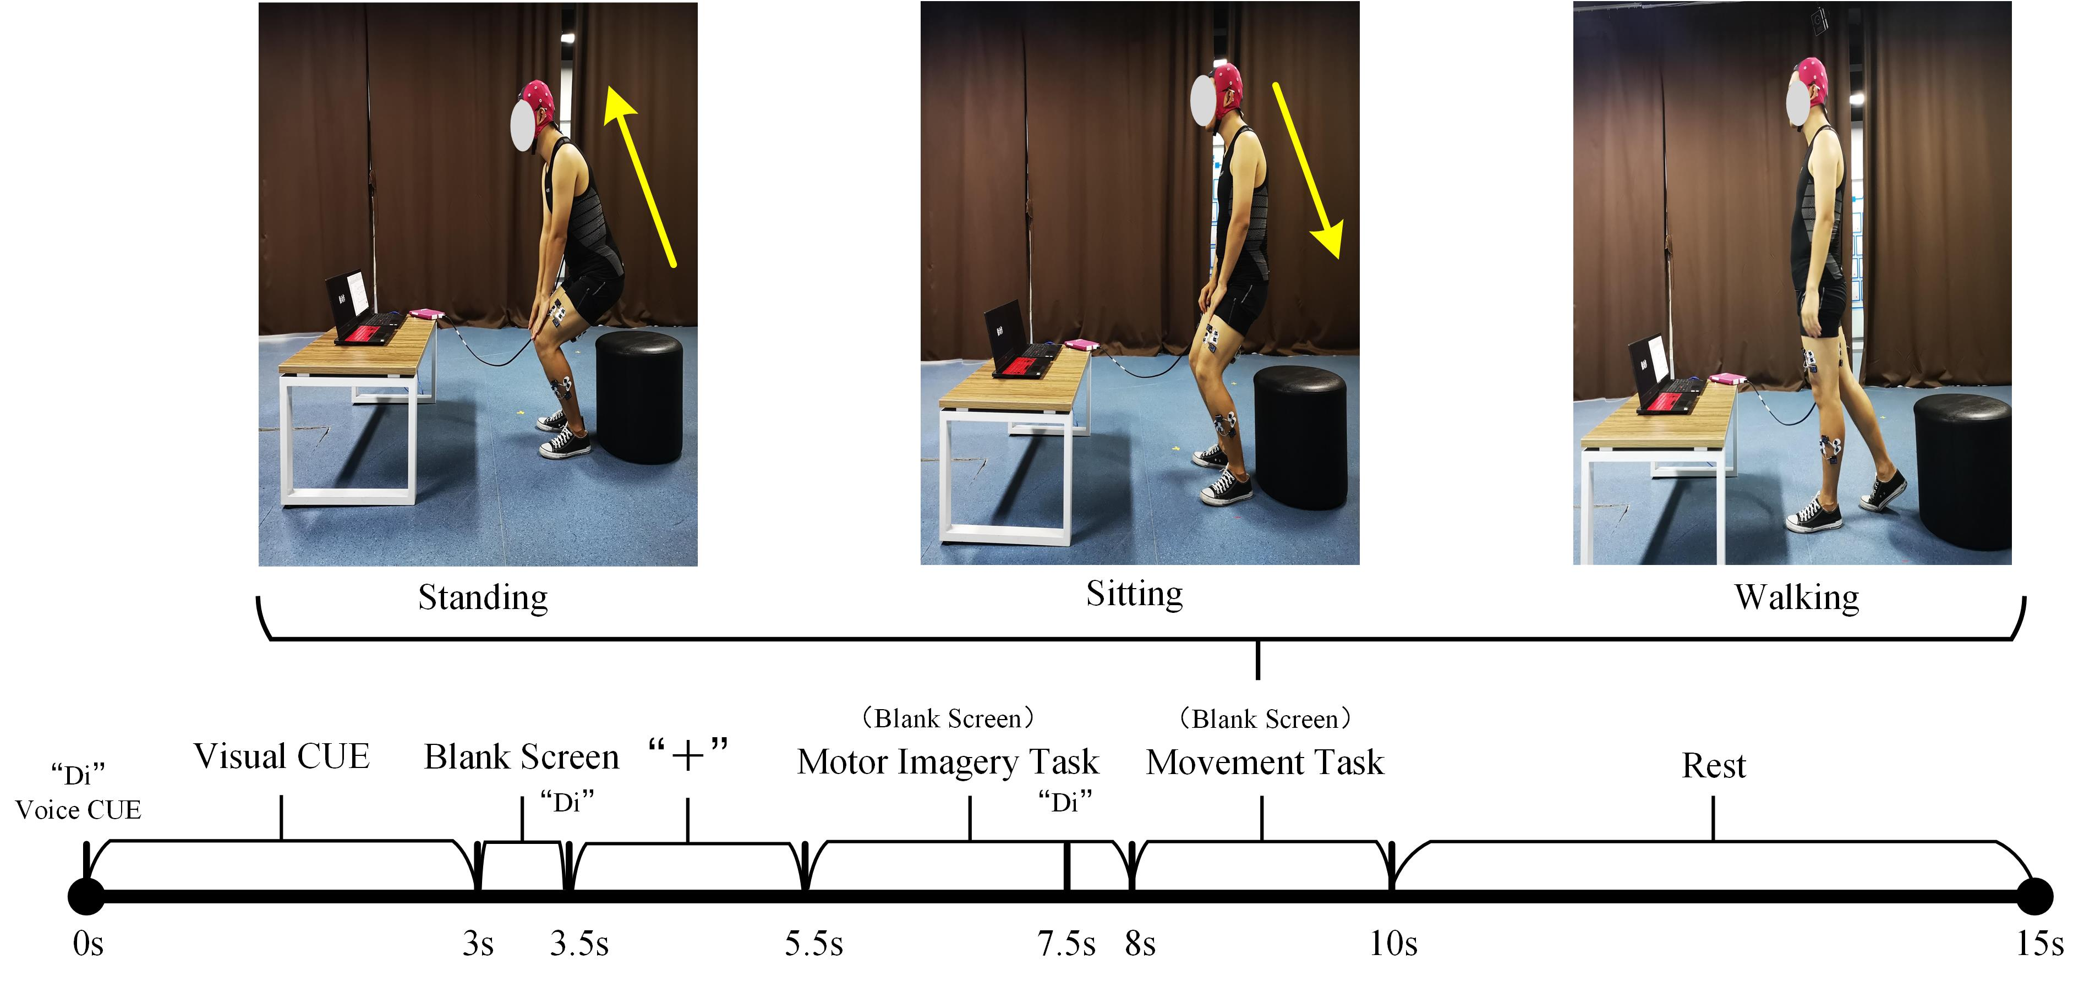
Experiment and Results
In order to verify the effectiveness of the proposed method, we tested the movement classification accuracy of our method on the public dataset PhysioNet and the self-constructed dataset LLM-BCImotion in both within-subject and cross-subject cases, respectively.
 | Subject | Movements | Sample size
PhysioNet | 105 | Left hand, right hand, both hands, both feet | 84/movement/subject
 | Subject | Movements | Sample size
LLM-BCImotion | 10 | Stand up, sit down, walk | 30/movement/subject

Slide 12
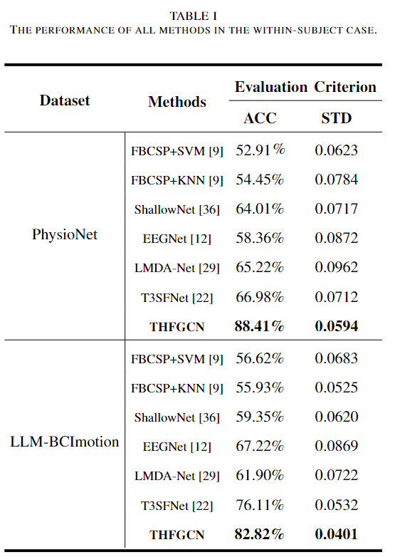
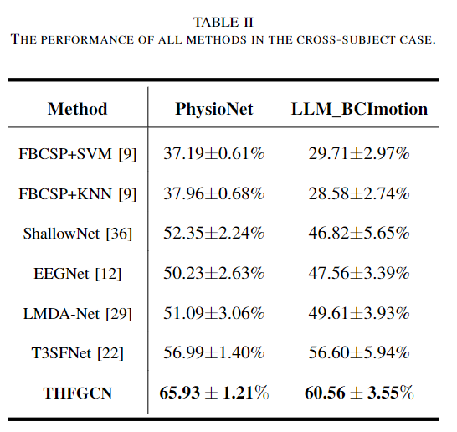
Within-subject Case
Cross-subject Case
Notes:
This is the experiment result. It can be clear see that our method get the best performance in both within-subject and cross-subject case.

Slide 13
Frequency Band Weight Analysis
Notes:
We first visualized the weights of the sub-bands learned by EFTM, as shown in the blue histogram in Fig. We then calculated the energy ratio of each sub-band, with a higher ratio indicating greater EEG activation in that band during motor imagery, as shown in the line graph in Fig.
We can clearly see that there is a strong correlation between the energy ratio of the frequency bands and the weights of the frequency bands, which indicates that our proposed EFTM can effectively extract the motor imagery responses frequency from different subjects.
In addition, it can be seen that the frequency band energy ratios are not the same for different subjects, which is consistent with our previously highlighted conclusion that the motor imagery response frequency bands are not the same for different subjects.
Notably, a universal trend is the high energy ratio in the 28-38 Hz range for all subjects during MI, corresponding to the $\beta-3$ frequency band in the BCI field. This heightened activity likely signifies engagement in intricate motor-related cognitive processes, such as motor planning and focused attention, which are pivotal to MI tasks.

Slide 14
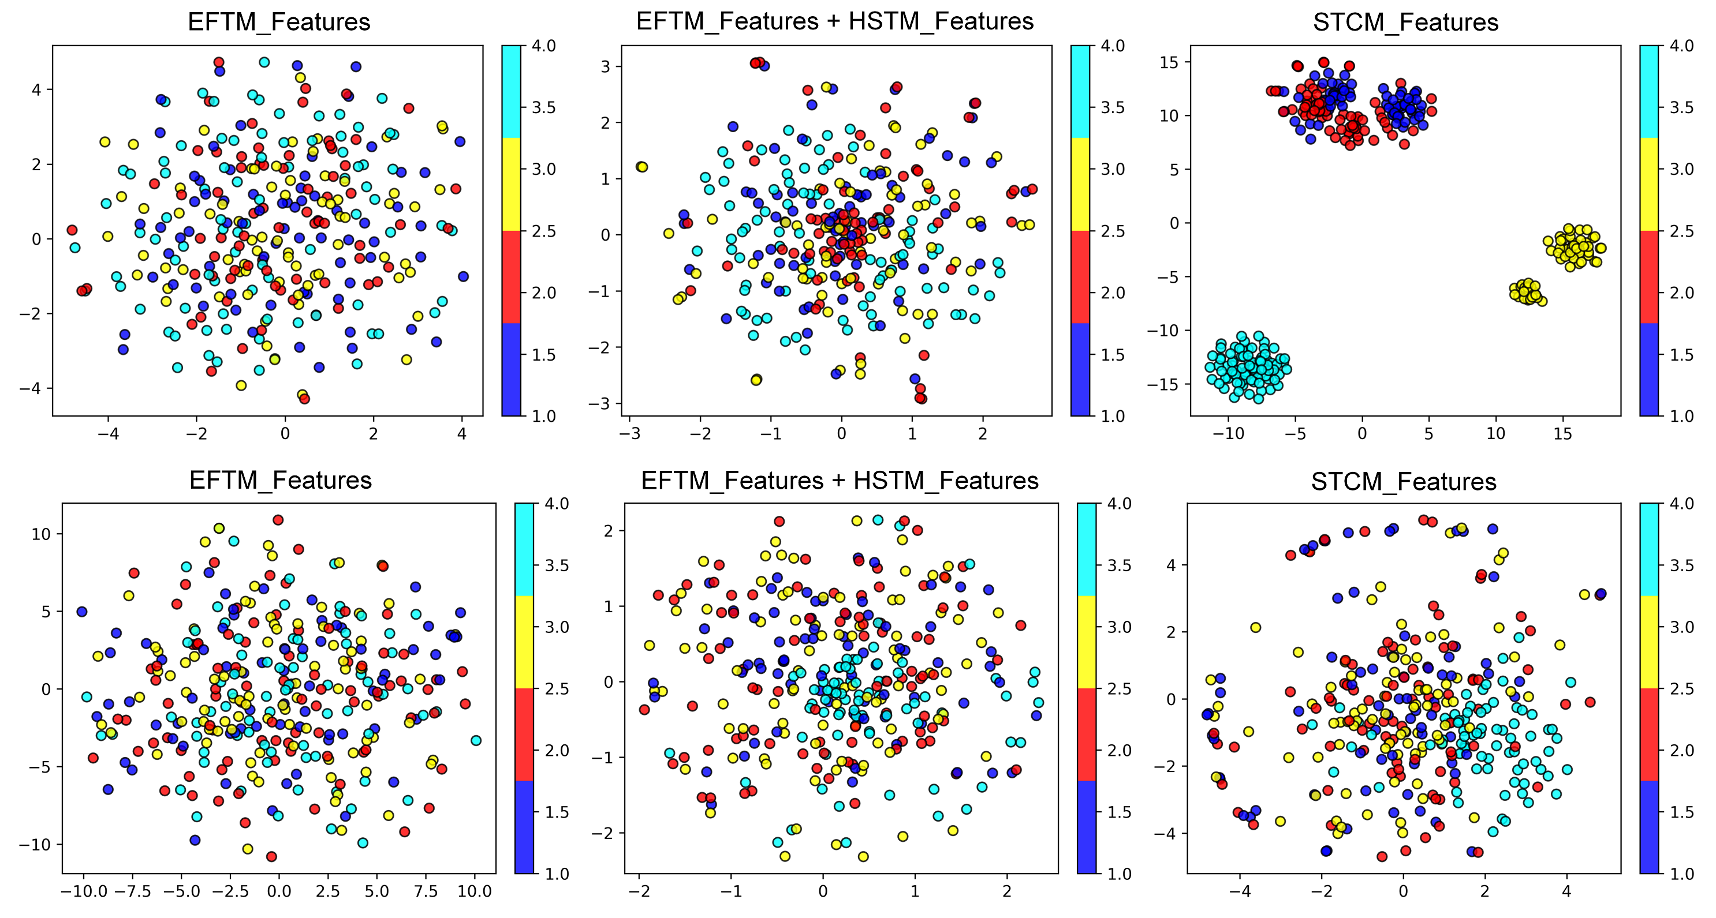
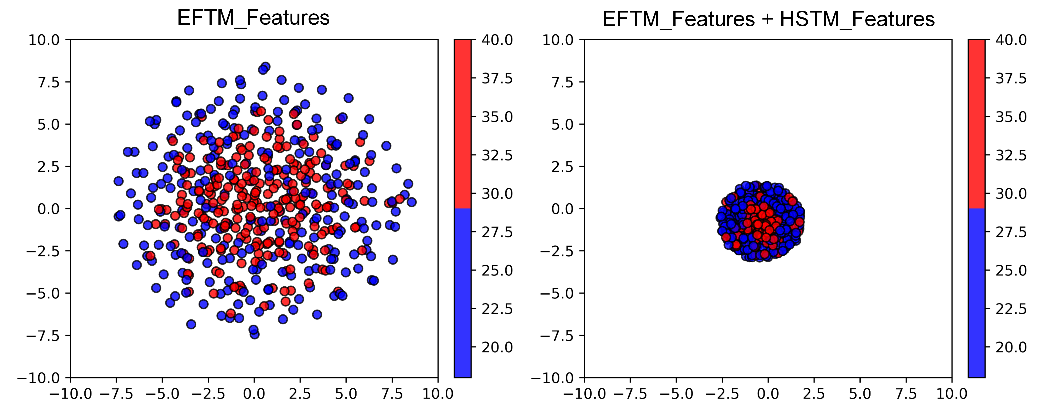
T-SNE Feature Visualization Analysis
Within-subject Case
Cross-subject Case
Notes:
To further explore the impact of our proposed modules on classification performance, we implement feature extraction via the EFTM module, the EFTM and HSTM module, and the STCM module for each dataset sample. Then, we performed the dimensionality reduction analysis using the T-SNE method.
Different colors means samples with varying labels.
In the within-subject case, after the EFTM module processing, the features for various labels remain linearly inseparable. With the introduction of the HSTM module, the feature distribution distances across all labels narrow immediately, but the both feet MI samples (cyan) still separate from the others. We think that this separation is because the differing brain activation regions between feet and hand movements, and this spatial structural variability is attended by the HSTM.
With the integration of the STCM, the features across all labels achieve clear linear separability. Similar phenomena shows in the cross-subject case. In short, progressive enhancement toward linear separability is evident following the different module processing. Hence, we can conclude that each module in the proposed method plays a crucial role in the model and effectively influenced the MI classification performance.
To further validate the effectiveness of the proposed HSTM in the cross-subject case, we executed the T-SNE analysis on features from identically labeled samples across different subjects. Notably, after the HSTM processing, the distance between features from identically labeled samples but from varied subjects shows a marked reduction. This result demonstrates the critical role of the HSTM in the cross-subject case, confirming its efficacy in enhancing the method's ability to generalize to new subjects.

Slide 15
Feature Interpretability Analysis
Notes:
In order to see if our method is able to extract features that are physiological interpretable, we visualized and analyzed features from different layers. This figure gives some representative topographic scalp plots of feature maps for the PhysioNet dataset. It can be clearly shown that the modules of our method focused on the central (FC, C, CP) and frontal (F)/pre-frontal (Fp) regions of the human brain. More specifically, some feature maps activate EEG channel nodes such as C3, CZ, C4, Fp1, and Fp2, which is consistent with previous studies. These nodes are shown to be strongly correlated with hand movement imagination, and their channel features are the most discriminative.

Slide 16
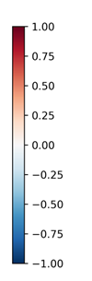
Feature Interpretability Analysis
Notes:
the feature map activates channel nodes in the relevant regions to the F7, Fp1, Fpz, Fp2, Cz, and Cp2 channels. These channel nodes involve the left dorsolateral prefrontal cortex, the prefrontal cortex, the primary motor cortex, and the right posterior cingulate cortex. These cortexes have been closely associated with lower limb MI and have been a key area of interest in the study of physiological activity in lower limb-related brain regions.
In summary, our proposed method can not only effectively extract brain region features related to upper and lower limb MI, but also, the extracted features have practical physical meaning, affirming our method has robust interpretability.

Slide 17
Thank you for watching!

