Slide 1
BRIDGING THE REALITY GAP
Using Sim-and-Real Co-Training & Automated Creation of Digital Cousins.
Shreyas Wade

Slide 2
Agenda
Motivation
The Challenge: The Data Bottleneck
The Strategy: Sim-and-Real Co-Training
The Paradigm Shift: Cousins vs. Twins
The Enabler: ACDC Pipeline
Impact & Results

Slide 3
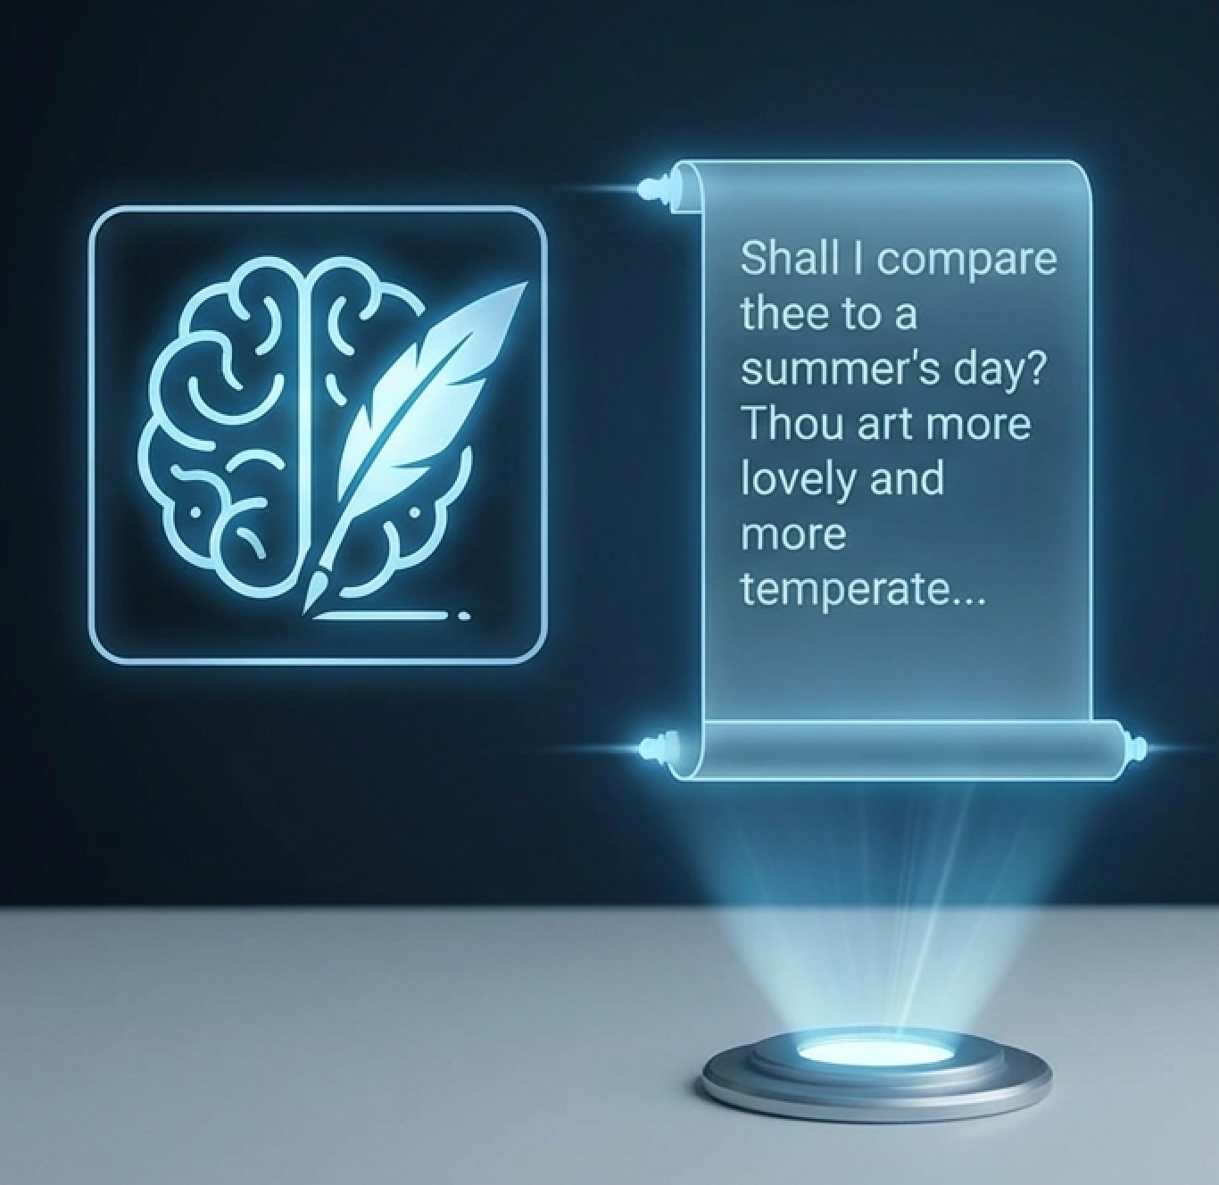
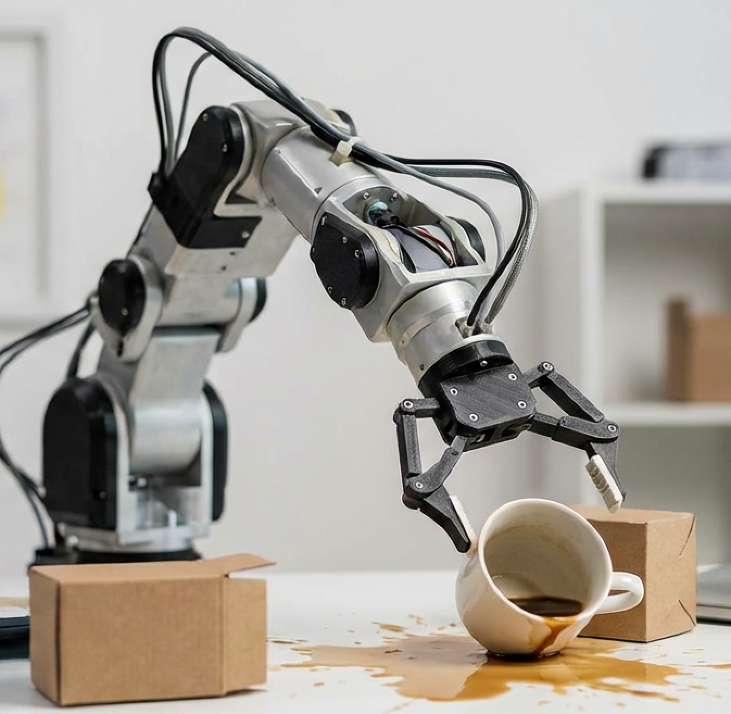
Motivation
We solved intelligence.
But not movement

Slide 4
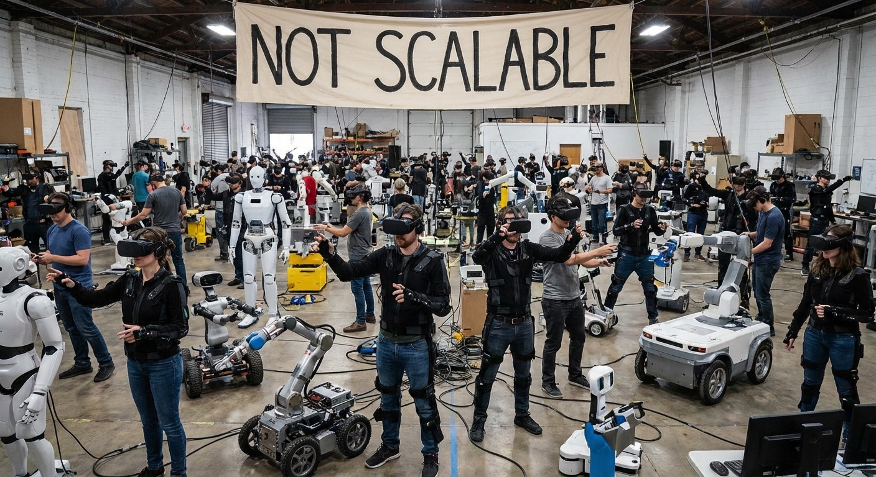
Motivation
The Economic Wall

Slide 5
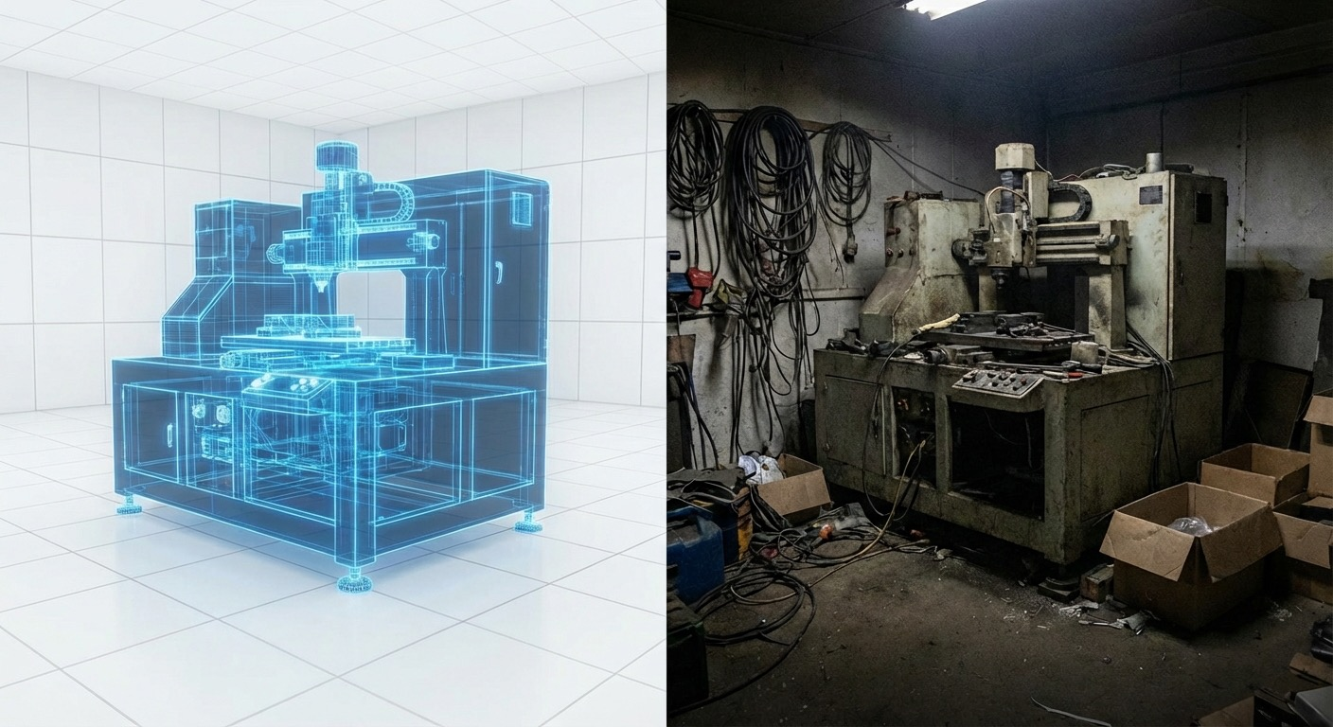
Motivation
The “Simulation Trap”

Slide 6
The Challenge
Data Bottleneck
Robots need massive data to learn skills (e.g., picking up a cup).
Real Data is expensive, slow, and dangerous to collect.
Simulation Data is cheap and infinite, but...
The Reality Gap: Simulators don't perfectly match physics/visuals of the real world.

Slide 7
Sim-and-Real Co-Training
Old Approach (Sim-to-Real)
Train in Simulation -> Transfer to Reality
New Approach (Co-Training)
Train in Simulation Train in Reality
+

Slide 8
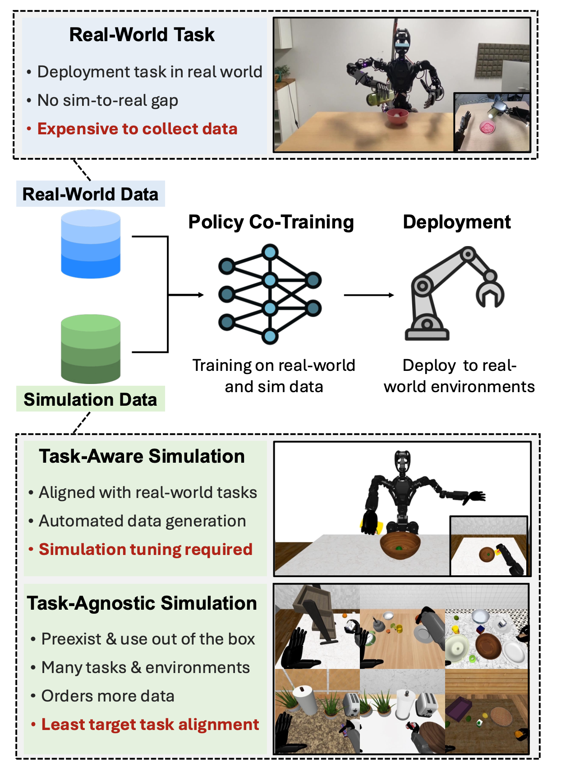
Sim-and-Real Co-Training
Old Approach (Sim-to-Real)
Train in Simulation -> Transfer to Reality
New Approach (Co-Training)
Train in Simulation Train in Reality
+
Figure 1 :Co-training with the help of Real-World Data and Simulation Data [1]

Slide 9
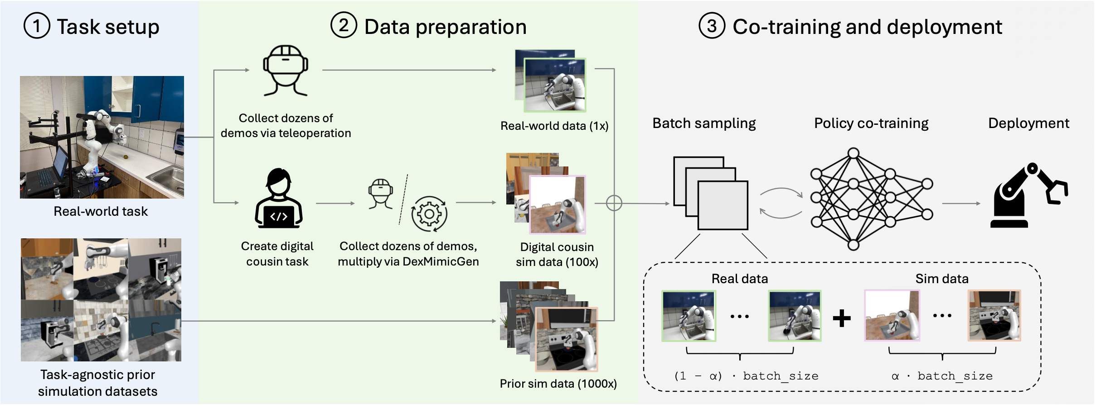
The Co-Training Recipe
+
Figure 2 :Co-training pipeline [1]

Slide 10
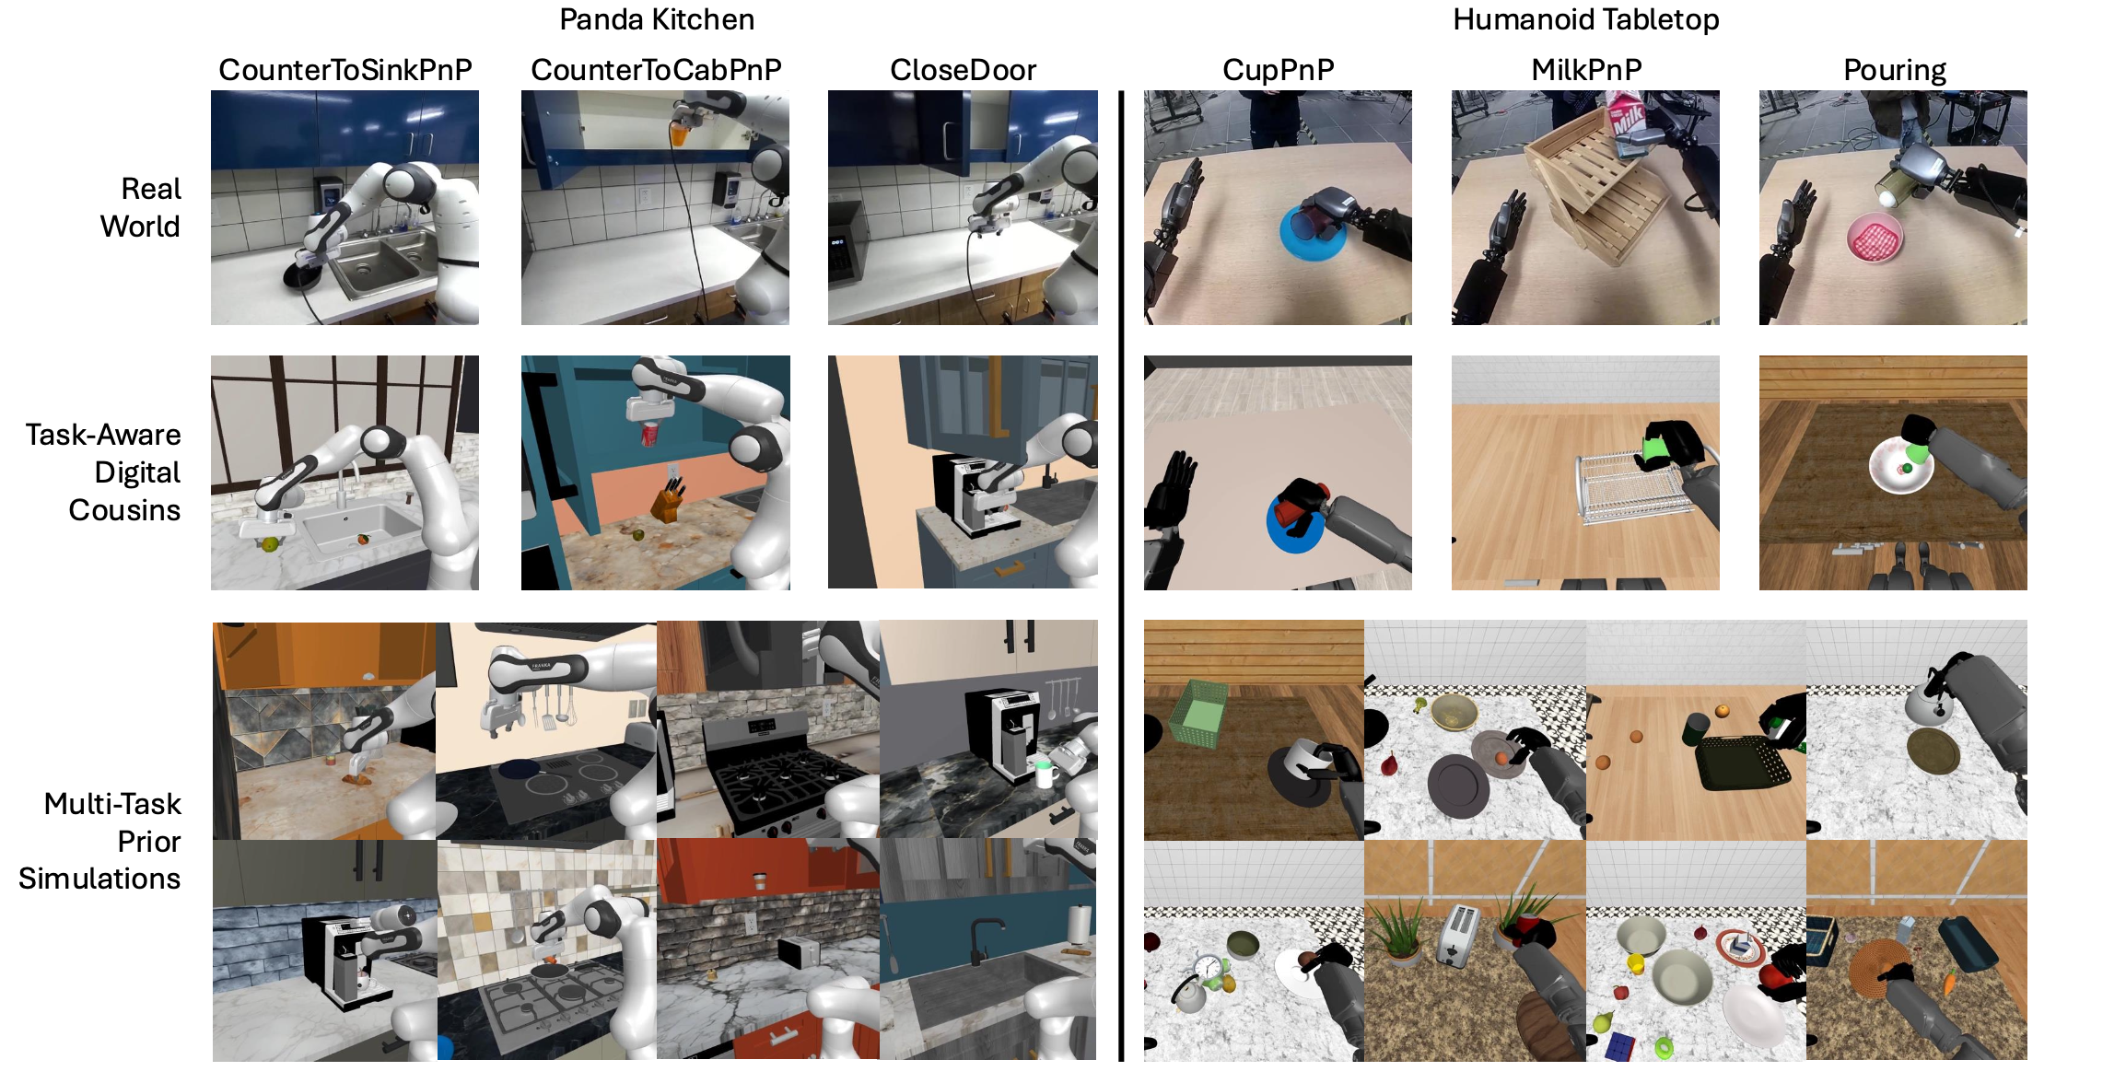
Types of Simulation Data
+
Figure 3 : Real
world and
simulation Tasks
[1]

Slide 11
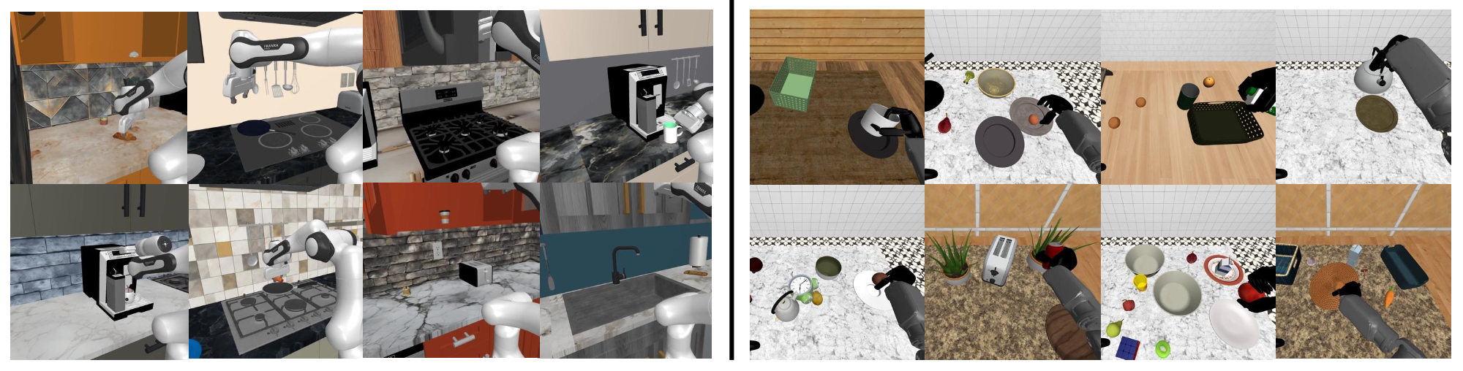
Task-Agnostic Simulation ("Prior Data")
Figure 4 : Prior Task-Agnostic Simulation Data[1]
Pros: Huge amount of data available instantly.
Cons: The kitchen in the game looks nothing like your real kitchen.

Slide 12
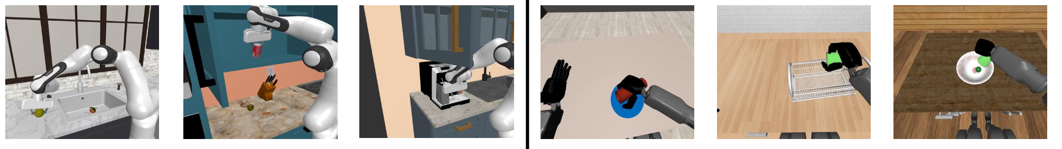
Task-Aware Simulation ("Digital Cousins")
Pros: Highly aligned with reality.
Cons: Usually very hard to build manually.
Figure 5 : Prior Task-Agnostic Simulation Data[1]

Slide 13
The Traditional Approach: Digital Twins
A precise, 1:1 replica of the real world.
Requires exact measurements, laser scanning, and manual artist labor.
Goal: Perfect physics and visual match.

Slide 14
Problems with Digital Twins
Expensive
Brittle
Overfitting

Slide 15
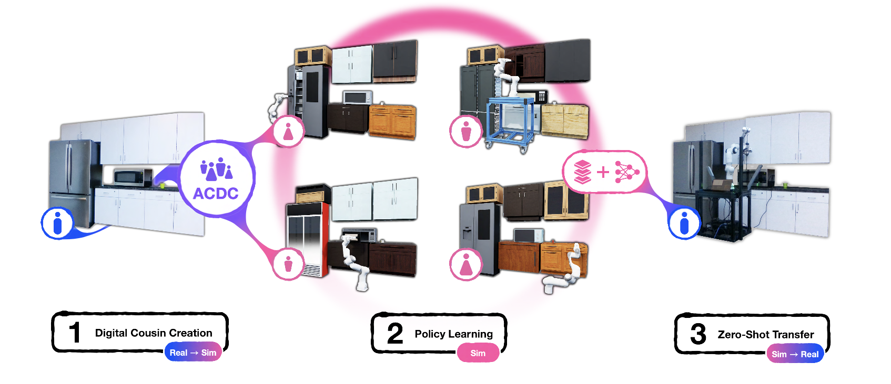
The Solution: Digital Cousins
Figure 6: Interactive Digital Cousin scene cration from a single image[2]

Slide 16
ACDC: Automated Creation of Digital Cousins
What is. : Pipeline to generate scenes automatically
Input : A single RGB image
Output : A fully interactive simulation.

Slide 17
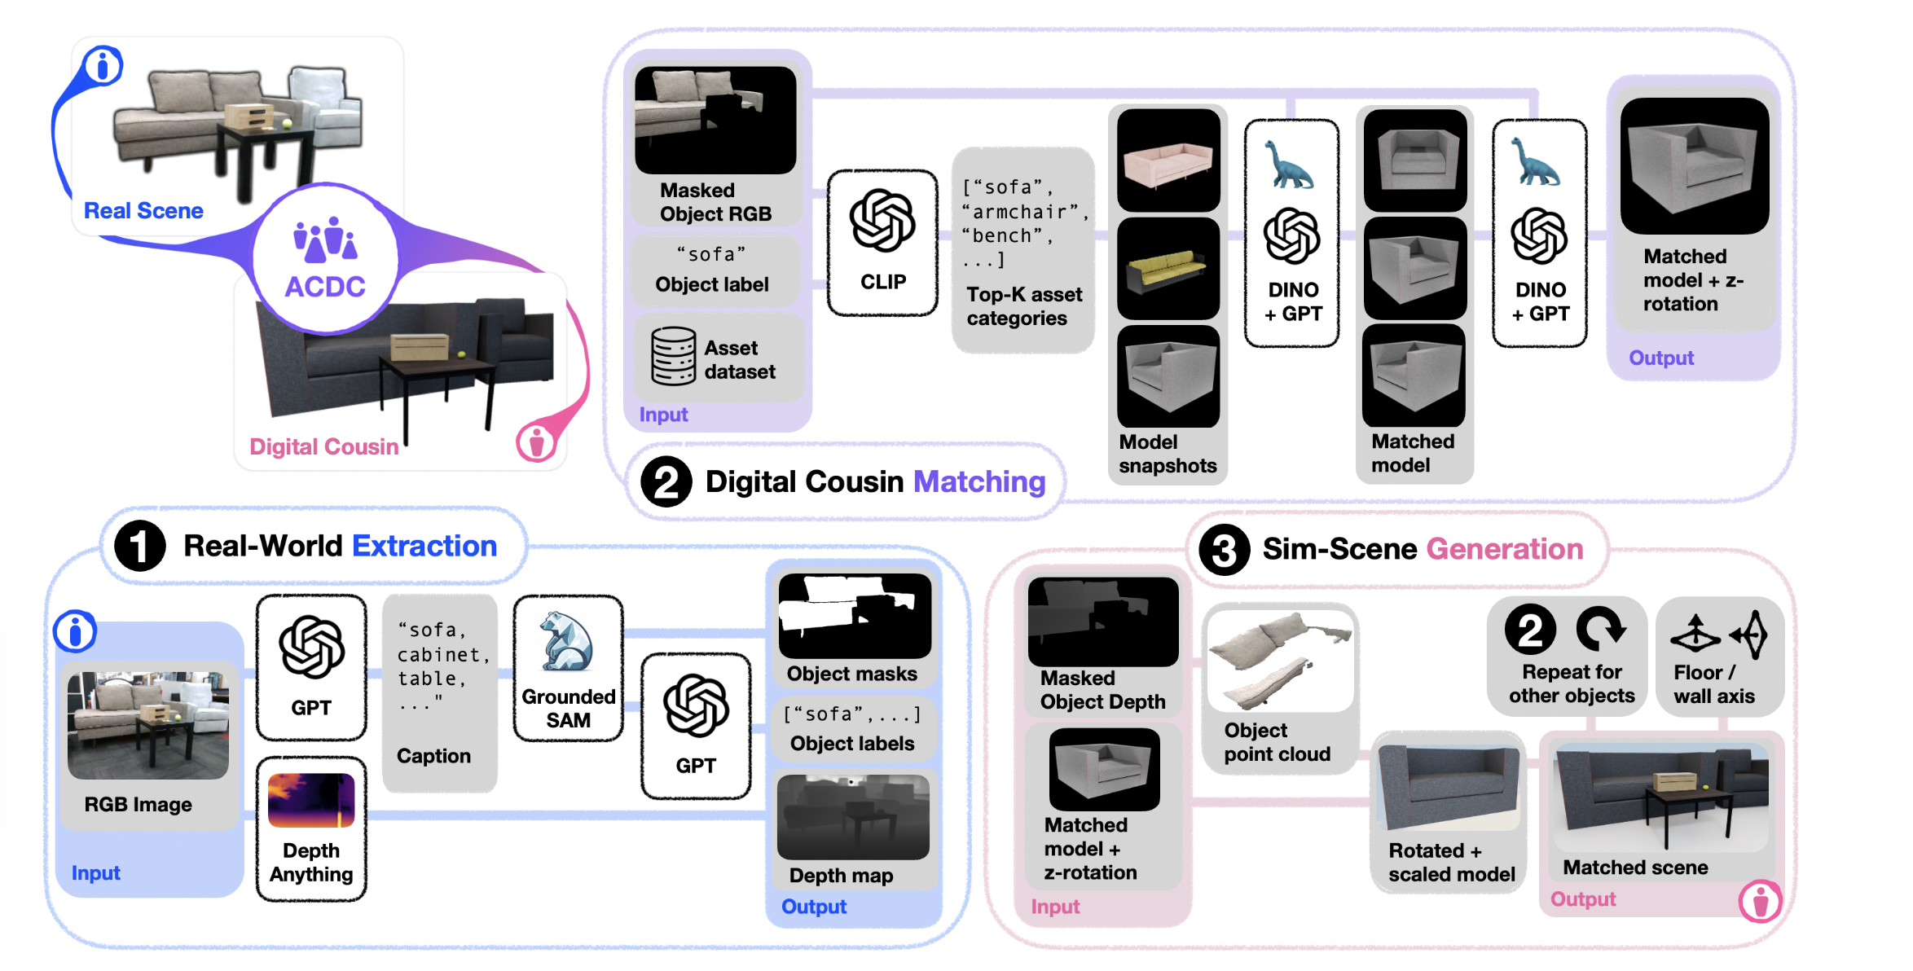
ACDC: Working - Extraction & Matching
Figure 7 : ACDC extraction pipeline [2]

Slide 18
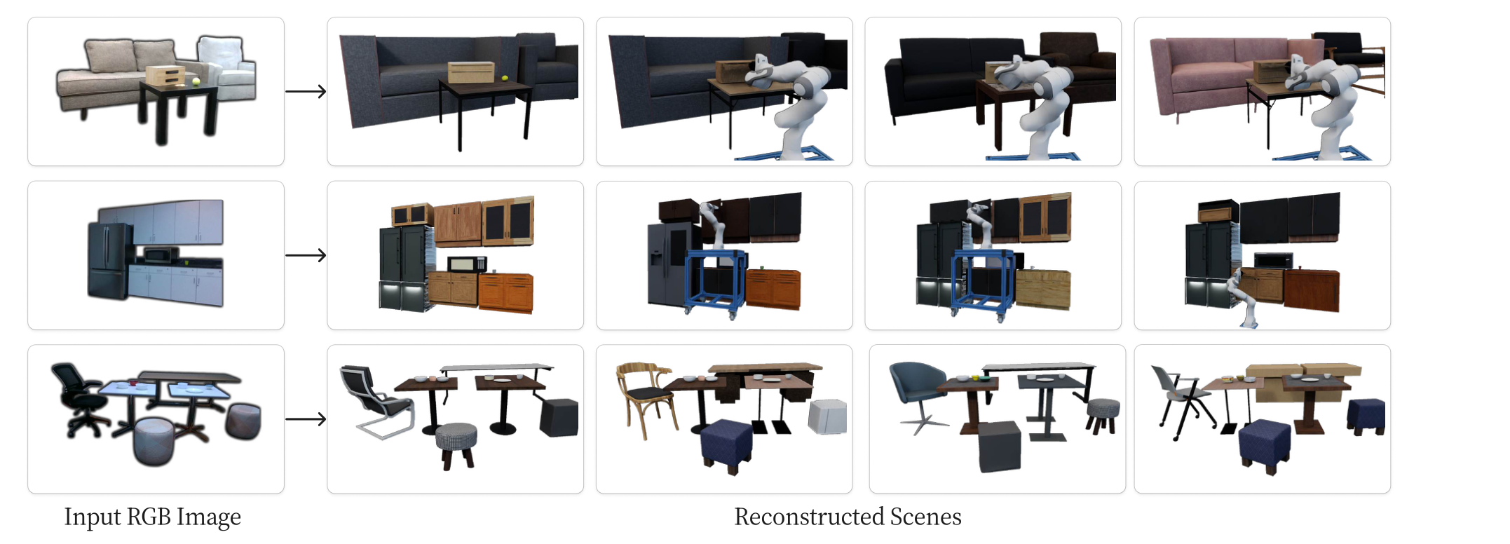
ACDC: Working - Generation & Physics
Figure 8 : Qualitative real-to-sim digital cousin scene generation results [2]

Slide 19
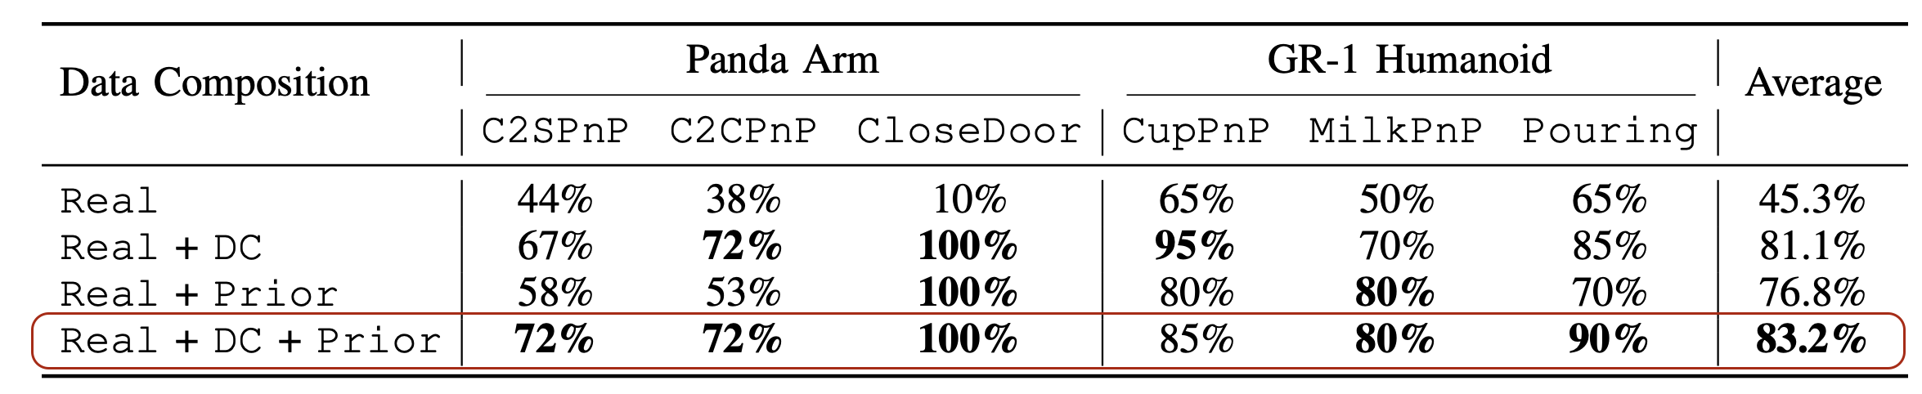
Results & Conclusion
Table 1 :Effect of different simulation data in the co-training mix [1]

Slide 20
References
[1] A. Maddukuri, Z. Jiang, L. Y. Chen, S. Nasiriany, Y. Xie, Y. Fang, W. Huang, Z. Wang, Z. Xu,
N. Chernyadev, S. Reed, K. Goldberg, A. Mandlekar, L. Fan, and Y. Zhu, “Sim-and-Real
Co-Training: A Simple Recipe for Vision-Based Robotic Manipulation,” arXiv preprint
arXiv:2503.24361, 2025.
[2] T. Dai, J. Wong, Y. Jiang, C. Wang, C. Gokmen, R. Zhang, J. Wu, and L. Fei-Fei, “Automated Creation
of Digital Cousins for Robust Policy Learning,” in Proceedings of the 8th Conference on Robot Learning (CoRL),
Munich, Germany, 2024.

Slide 21


Thank you

