Slide 1
Sound Recognition in Robotics
Presentor: Sabeeh ur Rehman Sulehri
Date: 11th December 2025
Notes:
Welcome
Sound Recognition in Robotics.
subtopic of perception
Lidar, camera etc
shine some light on.

Slide 2
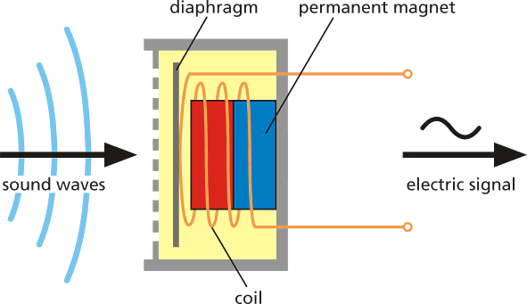
What is Sound Perception
Sound = vibrational waves in a medium
Waves move air → vibrate microphone diaphragm
Diaphragm motion → electrical signal
Digitized as a waveform (time domain)
Microphone is the basis for sound perception
Notes:
first what is sound
vibrational wave traveling through a medium — usually air
diaphragm move
solenoid effect
electrical signal as waveform (in time domain) or frequency etc microphone
sound analysis, sound recognition etc

Slide 3
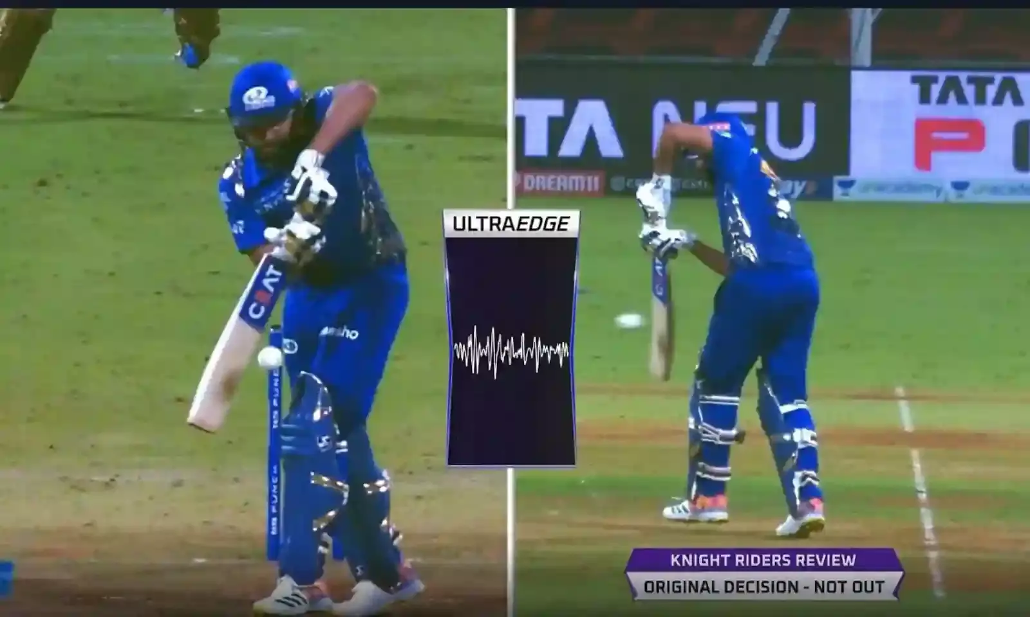
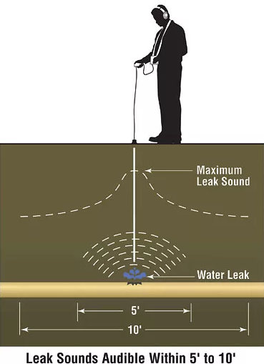
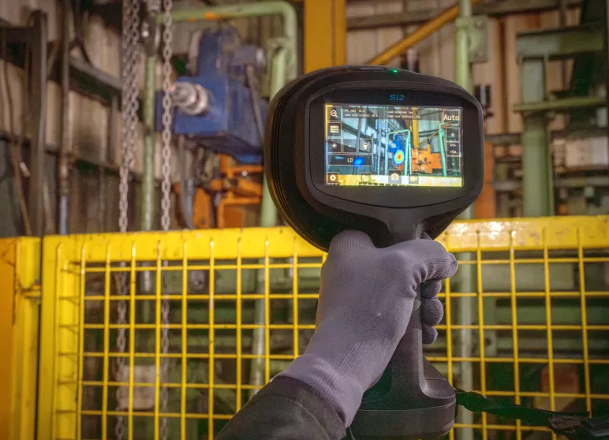
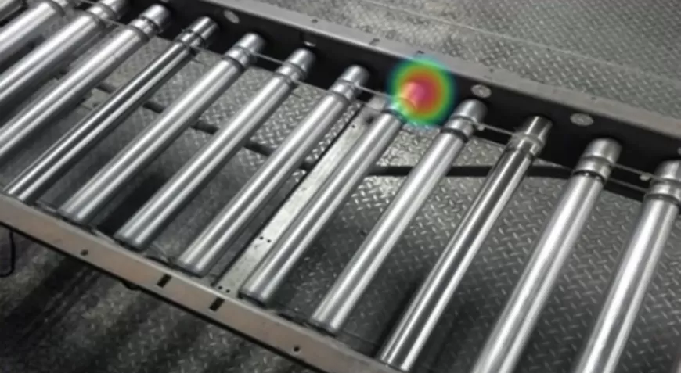
Acoustic Information and it’s applications
Impact sounds → contact detection, tool interaction
Resonance → material recognition
Flow sounds→ liquid monitoring, leak and blockage detection
Mechanical and motor noise → machine/fault diagnostics
Ambient/Environmental sounds → localization, human activity detection

Slide 4
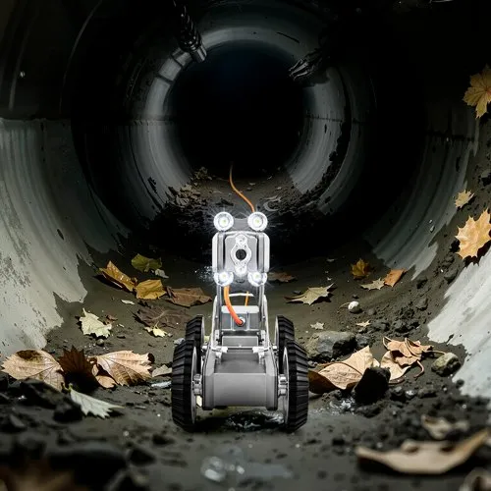
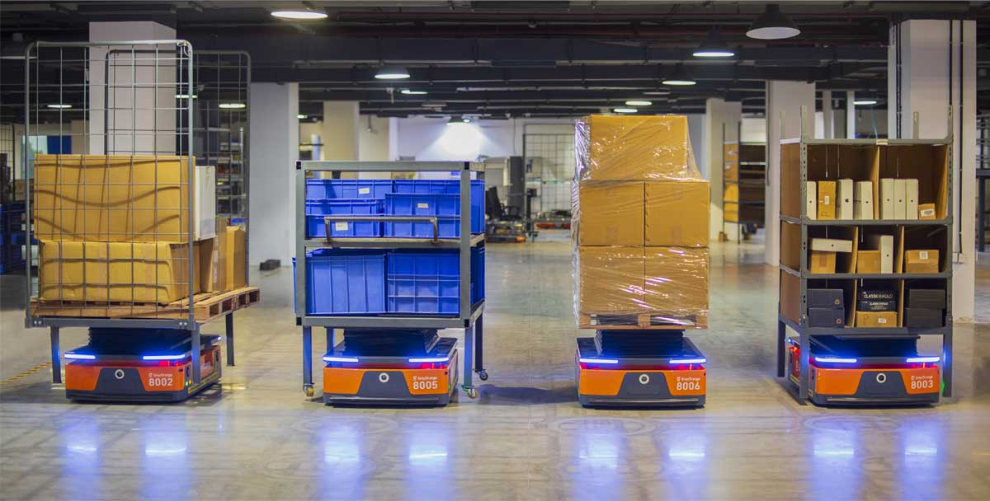
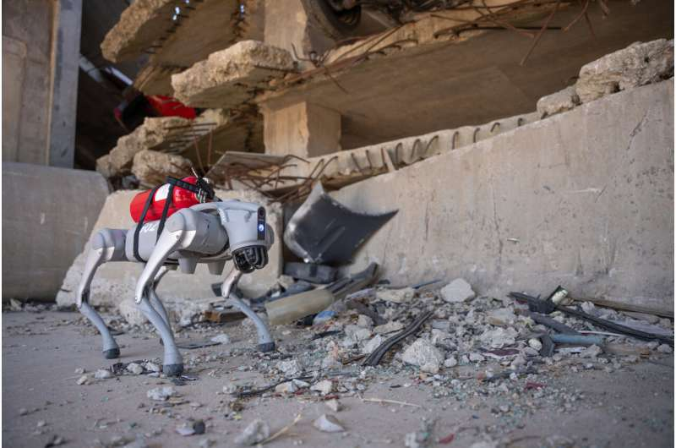
Why Robots need Audio perception
Identify leaks/blockages/sparks in pipes and sewers
Locate survivors in disaster sites
Detect falling or breaking items in warehouses
Humanoid Robots
Notes:
Large warehouses would need many cameras or humans looking over for mistakes
But if robots are already present there then how about they also do that by monitoring the sounds passively
Robots that can go into tight sewers and pipes where humans can’t easily go and detect flow issues or listen to sparks
Robot dogs are good at movement and so good at finding people in debris but locating sounds
Humanoid robots need sound because if we are copying humans then we need to copy this aspect too

Slide 5
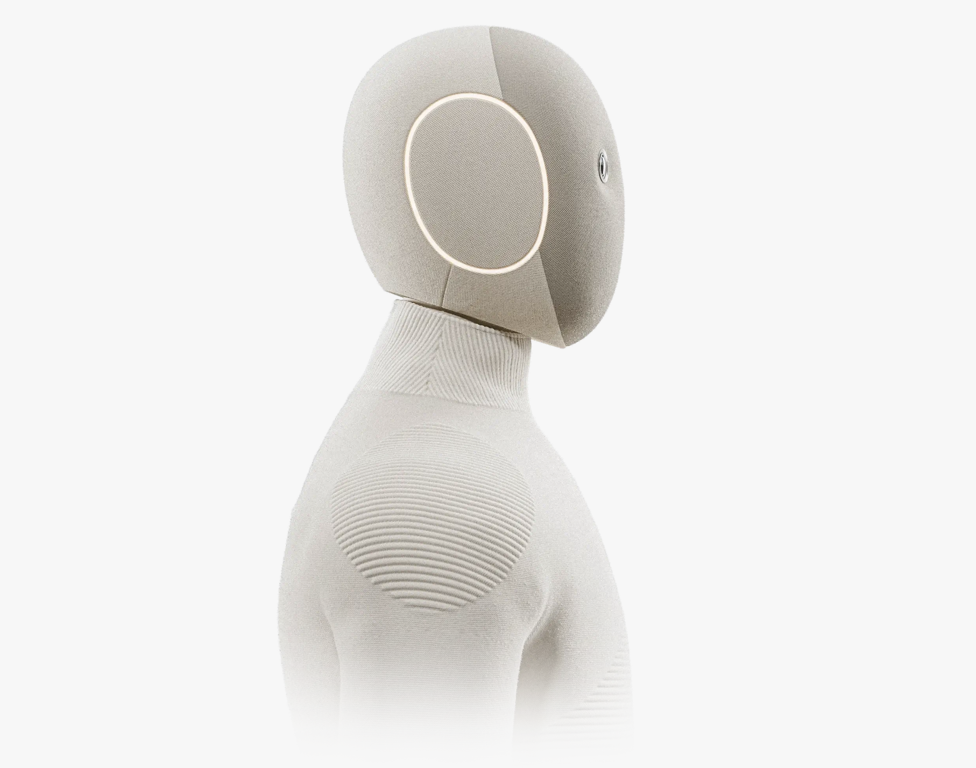
Human-Inspired Multimodal Perception for Robots
combine vision, touch, and sound like humans
Recognize people and hold conversations and respond to voice cues
robust in noisy environment
Assist with household chores and activities
barista, cooking, and kitchen tasks
Notes:
Modern humanoids are expected to behave like humans therefore, they use humans’ senses accordingly and sound plays a huge role
They can recognize who’s commanding them and hold conversations accordingly.
Voice cues is like listen to coughing, asthma attack
Noise cancellation is used in noisy environments
Can do tasks like …

Slide 6
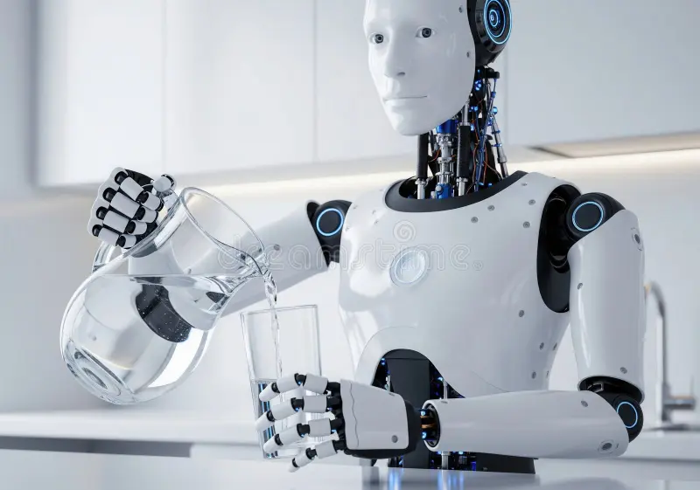
Pouring. A Benchmark for Audio Perception
Liquids are hard to perceive
Sound reveals internal liquid dynamics
Pouring produces rich acoustic signatures
Ideal testbed for audio sensing
Next: 3 papers
Notes:
It is a benchmark because it is hard to perceive liquids
Transparent, sparkling water
Why do u need to perceive liquid? Because sound reveals internal liquid dynamics
It reveals that because pouring produces rich acoustic signatures
Which means the flow produces sound temporally which can be processed

Slide 7
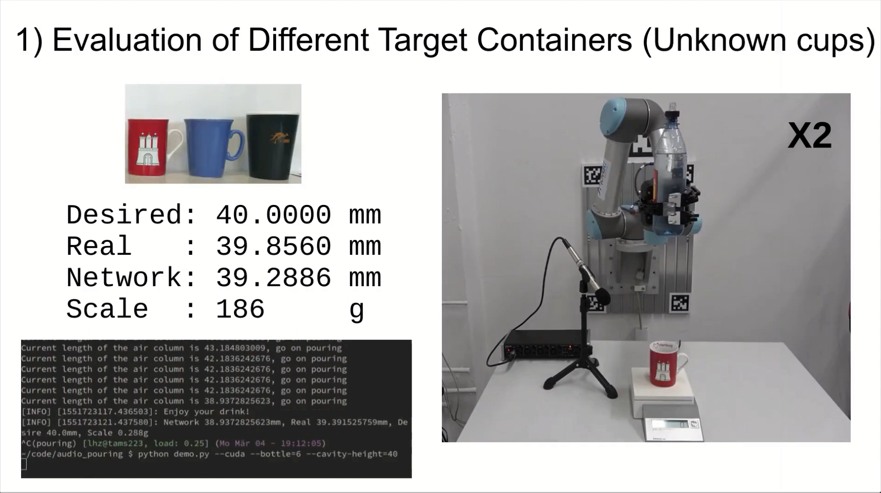
1) Demonstration of Liquid Height Estimation using sound only

Slide 8
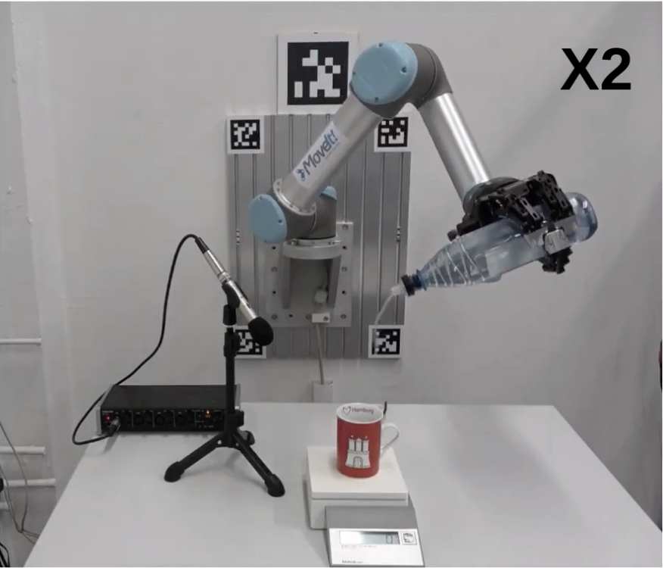
Liquid Height Estimation using Sound only
PouringNet model
Audio-only sensing
Resonance <-> Liquid Height
Good controlled performance but lacks real life scenario
Notes:
In the first paper, the robot listens to resonance changes during pouring. As the air column shrinks, pitch rises. Their model models these temporal patterns and estimates the fill level. It works very well in controlled conditions and shows how informative pure audio can be for fluid estimation.

Slide 9
Limitations of Audio only pouring
Container-specific behaviour
Needs steady pour stream
Noise-sensitive
Lacks physical feedback
Notes:
They thought it lacked physical feedback so they developed another model

Slide 10
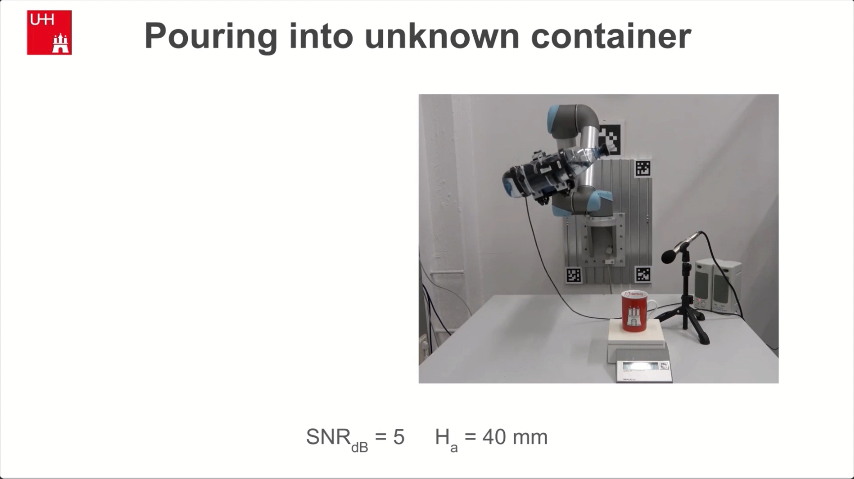
2) Demonstration of Liquid Height Estimation using sound + haptics
Notes:
The amount of tilt of the bottle at different volumes of water releases different amount of water the haptics give data on that too now so even if it gets noisy, the output from the bottle is more known
At more speed of water, the sound would change drastically which can be confused to the shape of the container, but hapics give better info and helps avoid this

Slide 11
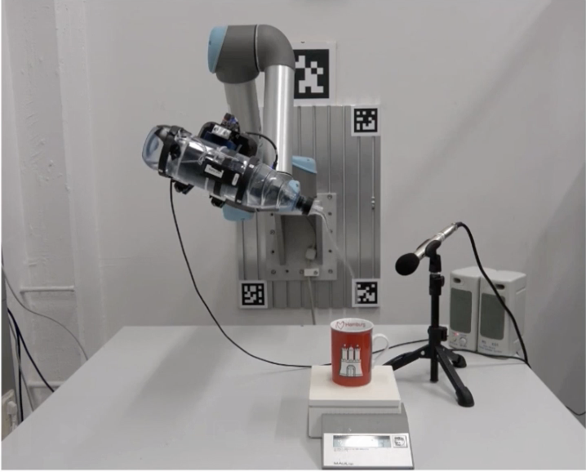
Liquid Height Estimation using Sound + Haptics
MPNet Model
Audio + force/torque fusion
Resolves noisy cases
Better generalization
Human-like multimodal strategy
Notes:
But again not the best
As muzzle
All the pouring being done from same container

Slide 12
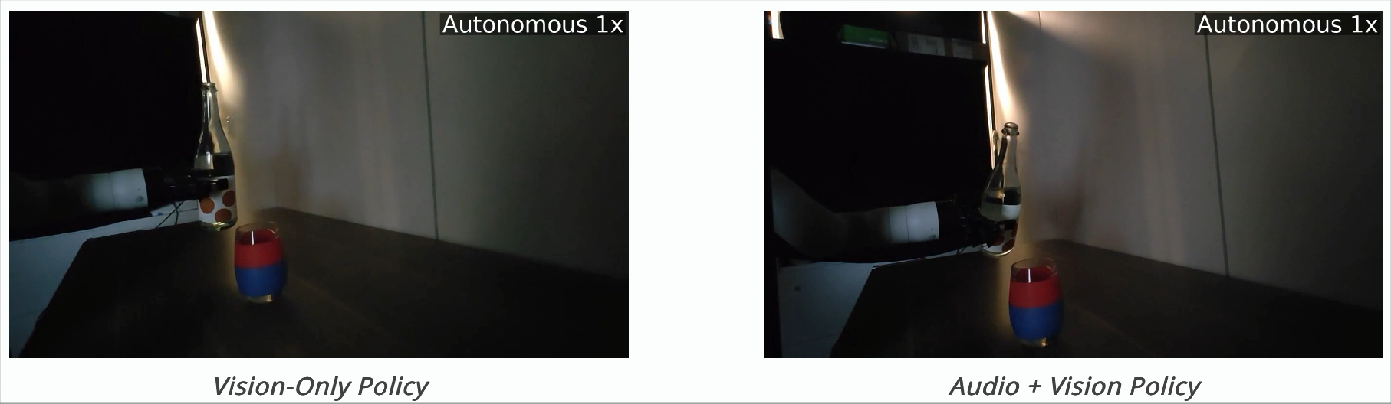
3) Multimodal Sim-to-Real Audio
Notes:
depth
also learn aboout the competiton model

Slide 13
Simulated Audio for Fluid Behavior
They used traditional physics-based simulator and real world sensory data which was used in modality specific generative model
Realistic multimodal simulation
Train with no real robot data, only simulated pours
Zero‑shot real‑world transfer
Broad and realistic liquid/container coverage
Best paper finalist CoRL 2025
Notes:
Video to diffusion model to Audio
Models trained in simulation transfer to the real world without retraining.
This provides scalability: thousands of liquids and containers can be generated digitally instead of recorded manually

Slide 14
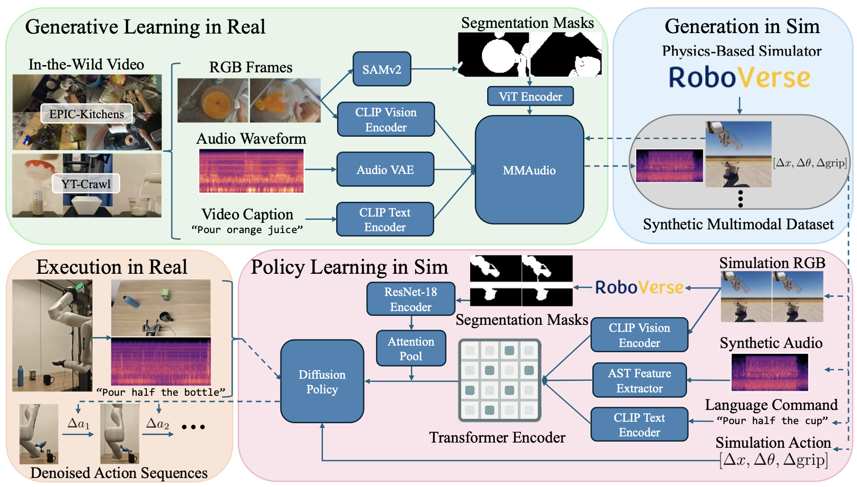
Future Work
Sound is becoming an essential aspect of robotics
For methods presentation
Go into the details of the models discussed in the papers
and how they work
Notes:
So very interesting

Slide 15
Thank you
Summary:
What is sound and how do we perceive it
What type of sounds can be used in applications
Why robots need Audio Perception
Humanoids
Pouring and the 3 papers that discuss it
Notes:
reflection from audio and navigation should have been mentioned as it is very old

Slide 16
References
[1] Liang, X., Xu, Y., Liu, X., & Zhu, S.-C. (2019). Making sense of audio vibration for liquid height estimation in robotic pouring. arXiv:1903.00650v2
[2] Liang, X., Xu, Y., Zhang, Y., & Zhu, S.-C. (2020). Robust robotic pouring using audition and haptics. arXiv:2003.00342v2
[3] Zhao, T., Li, P., & Chen, X. (2025). Learning fluid dynamics from audio for robotic manipulation. arXiv:2507.02864
[4] TAMS UHAM. (2019). Making sense of Audio Vibration for Liquid Height Estimation in Robotic Pouring [Video]. YouTube. https://www.youtube.com/watch?v=tdIcJb80qPc
[5] TAMS UHAM. (2020). Robust Robotic Pouring using Audition and Haptics [Video]. YouTube. https://www.youtube.com/watch?v=_U7zTyS338I
[6] Multigen‑Audio. (2025). Multigen‑audio: Learning multimodal sim‑to‑real robot policies with generative audio. https://multigen-audio.github.io/
[7] 1X. (n.d.). NEO home robot. https://www.1x.tech/neo

Slide 17
References
[8] Chengappa, C. (2022, May 10). Ultra Edge technology: What is it and what are potential reasons for a glitch in cricket-IPL. The Bridge. https://thebridge.in/cricket/what-is-ultra-edge-technology-reasons-for-glitches-in-cricket-ipl-31350The Bridge
[9] Which material is used to convert sound energy signals into electrical signals? (n.d.). Quora. https://www.quora.com/Which-material-is-used-to-convert-sound-energy-signals-into-electrical-signals
[10] The art of water leak detection. (n.d.). PM Magazine. https://www.pmmag.com/articles/100631-the-art-of-water-leak-detection
[11] Acoustic imaging for mechanical fault detection. (n.d.). Pro Thermal Imaging. https://prothermalimaging.com/acoustic-imaging-for-mechanical-fault-detection/
[12] Author unknown. (2025, December). AI-powered robotic dog assists humans in dangerous tasks. TechXplore. https://techxplore.com/news/2025-12-ai-powered-robotic-dog-human.html

Slide 18
References
[13] GreyOrange. (n.d.). History of robots in warehouse. GreyOrange. https://www.greyorange.com/warehouse/history-of-robots-in-warehouse/
[14] Vevor. (n.d.). Vevor. https://www.vevor.de/
[15] Humanoid robot pouring water [Photograph]. (n.d.). Dreamstime. https://www.dreamstime.com/humanoid-robot-demonstrates-precise-water-pouring-sleek-white-exterior-illuminated-blue-accents-transparent-image404401838

