Slide 1
In-Hand Object 6D Pose Estimation for Robot Manipulation
Yuyang Tu
TAMS Group, University of Hamburg
June 2025
Notes:
Good afternoon, professors and committee members.
My name is Yuyang Tu, and I’m honored to present my PhD research titled In-Hand Object 6D Pose Estimation for Robot Manipulation.
This work was conducted under the supervision of Prof. Dr. Jianwei Zhang at the TAMS Group, University of Hamburg.
Throughout this presentation, I’ll walk you through the motivation, challenges, proposed methods, experimental results, and future directions of this research.

Slide 2
ToolGPT: Language-Embedded 6D Pose Estimation
• Input: Language + Point Cloud
• LLM extracts semantic goal
• Output: Functional 6D pose
Notes:
The central goal of this work is to enable robots to understand which part of a tool to manipulate, and how, given only a natural language instruction and a point cloud of the tool.
Traditional 6D pose estimation methods focus on entire objects or known CAD models. However, in many tool-use scenarios, the robot must localize a specific functional part, such as the tip of a screwdriver or the bristle of a brush, depending on the task.
ToolGPT addresses this by estimating the 6D pose of the task-relevant part of a tool, conditioned on a natural language task prompt.
The input to the system is a segmented point cloud of the tool, along with a free-form task instruction. A large language model first parses the instruction into a semantic triplet: task, object, and part.
This semantic embedding is fused with geometric features from the point cloud via a cross-modal network, and a pose decoder outputs the predicted SE(3) pose of the part.
We supervise the training using a diffusion-based score network, which improves robustness to ambiguities and outliers.
ToolGPT generalizes across diverse tools and tasks, and can serve as a modular component in a broader language-to-action robot system.

Slide 3
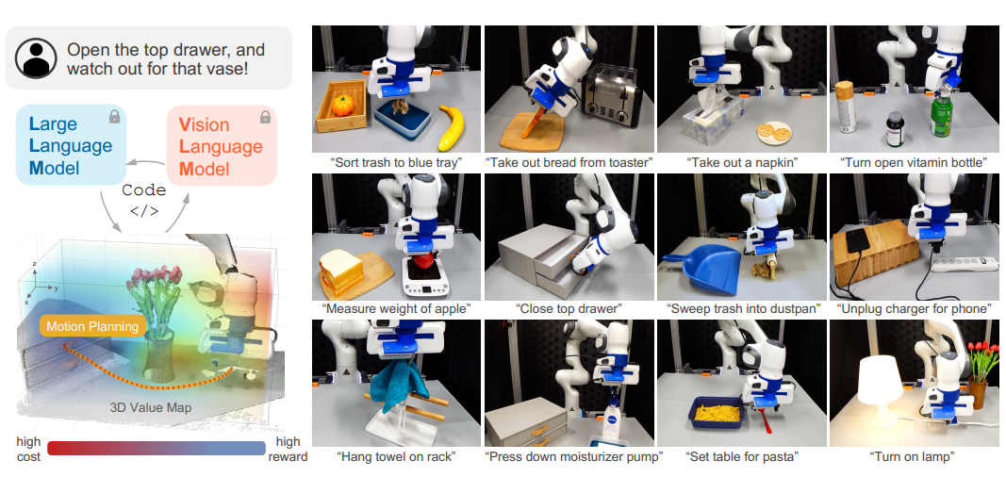
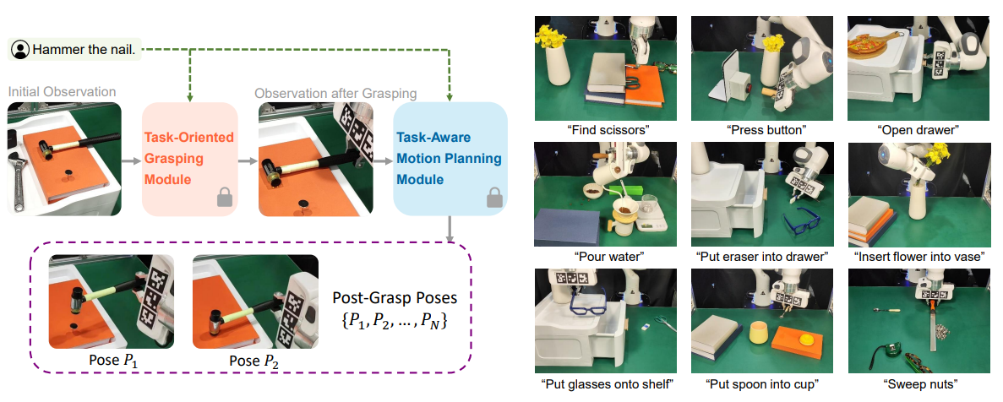
Background
Motivation
Related Work
  • VoxPoser [1] : Language → voxel maps via LLM and visual APIs
  • CoPa [2] : Foundation models infer spatial constraints between object parts
  • Both stop at spatial grounding; no SE(3) pose estimation
  • ToolGPT: Predicts 6D pose of functionally relevant part from natural language + 3D point cloud
[1] Huang, Wenlong, et al. "Voxposer: Composable 3d value maps for robotic manipulation with language models." arXiv preprint arXiv:2307.05973 (2023).
[2] H. Huang*, F. Lin*, Y. Hu, S. Wang, Y. Gao,CoPa: General Robotic Manipulation through Spatial Constraints of Parts with Foundation Models,IEEE/RSJ Int. Conf. on Intelligent Robots and Systems (IROS), 2024
Notes:
Recent advances have demonstrated that large language models (LLMs) possess strong commonsense reasoning capabilities, making them powerful tools for guiding robot behavior from natural language instructions.
For example, VoxPoser introduces a code-as-policy framework, where LLMs generate programs that invoke visual grounding APIs to produce 3D value maps. These maps help guide manipulation tasks without requiring task-specific training.
Another line of work is CoPa, which interprets spatial constraints between object parts using foundation models like GPT and CLIP.
In a hammering task, for instance, CoPa might infer the constraint "align the flat side of the hammer with the top of the nail".
This constraint expresses the desired spatial relationship, but it does not yield precise SE(3) poses required for real execution.
In contrast, ToolGPT bridges this gap by directly grounding natural language to the 6D pose of the functionally relevant part in a segmented point cloud.
This enables robots to perform tool-use tasks such as hammering or inserting, guided by abstract task descriptions.

Slide 4
Methodology
  • 160+ tool models (generated in NVIDIA Isaac Gym)
  • Each tool annotated with 6D pose of functionally relevant part
  • Point clouds captured from simulated multi-view cameras
  • Annotations include part names and 6D poses
Notes:
To generate diverse tools for our dataset, we use NVIDIA Isaac Gym as a simulation platform.
Tool geometries are procedurally generated using primitive shapes and CAD-like part combinations.
Each tool is composed of multiple labeled parts—such as handles, tips, or blades—which are essential for function-specific manipulation.
We simulate multi-view depth images and reconstruct segmented point clouds for each object.
Finally, we manually annotate the 6D pose of the relevant functional part for each tool and task label.

Slide 5
Methodology
Notes:
The goal of ToolGPT is to estimate the 6D pose of a functionally relevant part of a tool, conditioned on a natural language instruction and a segmented 3D point cloud.
The process begins with a free-form language instruction, such as “Insert the tip of the screwdriver into the hole.”
This instruction is parsed using a large language model, such as GPT, to extract three semantic elements: the task name ("insert"), the object name ("screwdriver"), and the part name ("tip").
These components form a semantic triplet, which is then embedded using a BERT encoder to produce a fixed-length semantic representation.
In parallel, the segmented point cloud of the tool is processed using a PointNet encoder, which extracts geometric and spatial features from the 3D data.
The language and visual features are fused using a cross-attention module.
This module allows the network to focus on the regions of the point cloud that are most relevant to the semantic context—specifically, the functional part indicated by the language input.
The fused representation is then passed to a PoseDecoder network, which predicts a candidate 6D pose consisting of a 3D position and a rotation quaternion.
To provide a probabilistic training signal, we use a score network trained via diffusion.
This score-based learning approach helps the model estimate the distribution of plausible poses, rather than a single point estimate.
To handle the inherent symmetry of many tools—such as screwdrivers or spatulas—we incorporate a symmetry-aware loss function.
This loss is designed to be invariant to certain rotations, ensuring that the model does not penalize equally valid pose predictions.
Overall, this architecture allows ToolGPT to perform fine-grained, semantically grounded pose estimation for diverse tool-use tasks, guided by language and informed by 3D geometry.

Slide 6
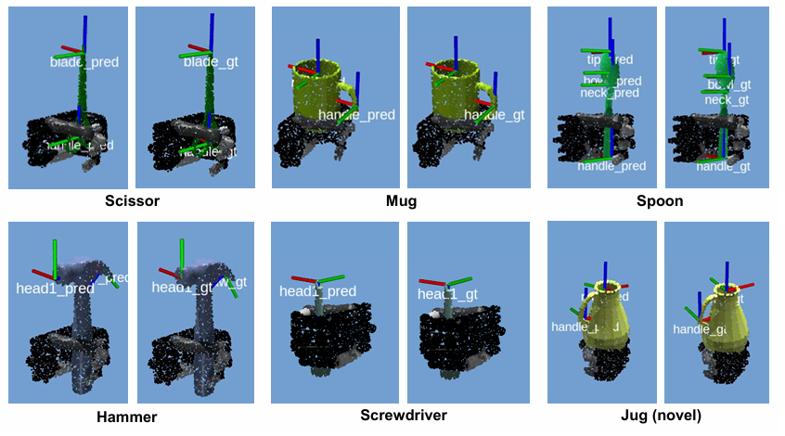
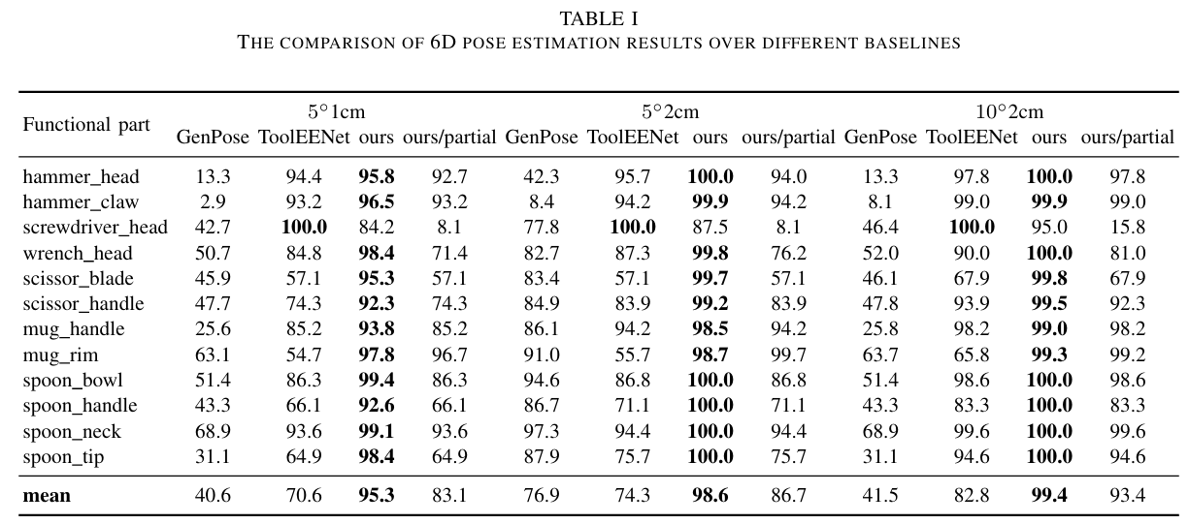
Methodology
Notes:
The goal of ToolGPT is to estimate the 6D pose of a functionally relevant part of a tool, conditioned on a natural language instruction and a segmented 3D point cloud.
The process begins with a free-form language instruction, such as “Insert the tip of the screwdriver into the hole.”
This instruction is parsed using a large language model, such as GPT, to extract three semantic elements: the task name ("insert"), the object name ("screwdriver"), and the part name ("tip").
These components form a semantic triplet, which is then embedded using a BERT encoder to produce a fixed-length semantic representation.
In parallel, the segmented point cloud of the tool is processed using a PointNet encoder, which extracts geometric and spatial features from the 3D data.
The language and visual features are fused using a cross-attention module.
This module allows the network to focus on the regions of the point cloud that are most relevant to the semantic context—specifically, the functional part indicated by the language input.
The fused representation is then passed to a PoseDecoder network, which predicts a candidate 6D pose consisting of a 3D position and a rotation quaternion.
To provide a probabilistic training signal, we use a score network trained via diffusion.
This score-based learning approach helps the model estimate the distribution of plausible poses, rather than a single point estimate.
To handle the inherent symmetry of many tools—such as screwdrivers or spatulas—we incorporate a symmetry-aware loss function.
This loss is designed to be invariant to certain rotations, ensuring that the model does not penalize equally valid pose predictions.
Overall, this architecture allows ToolGPT to perform fine-grained, semantically grounded pose estimation for diverse tool-use tasks, guided by language and informed by 3D geometry.

Slide 7
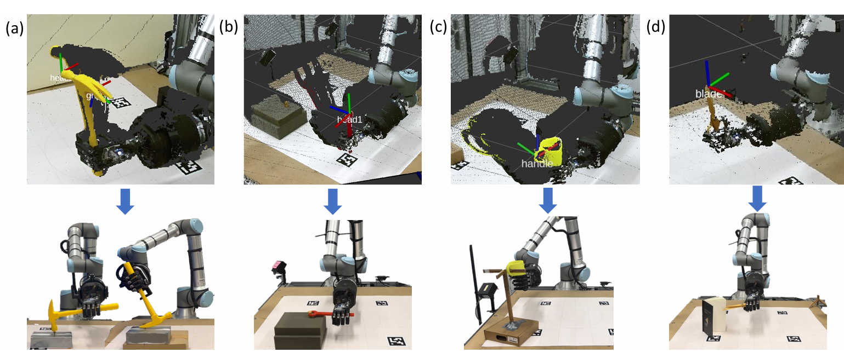
ToolGPT: Real Robot Tasks
• Generalizes to unseen tools
• Executes tasks like hammering, inserting
• Real-world success
“Hammer/Pull the nail”
“Unscrew the nut”
“Hang the mug on the shelf”
“Cut the paper”
Notes:
ToolGPT generalizes to novel tools and instructions...

Slide 8
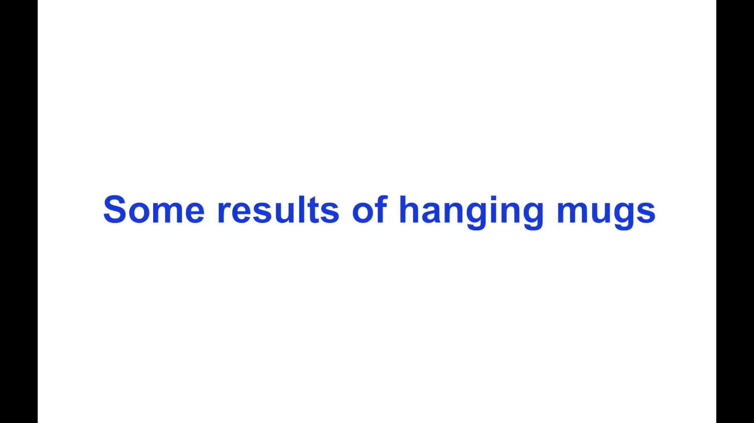

Slide 9
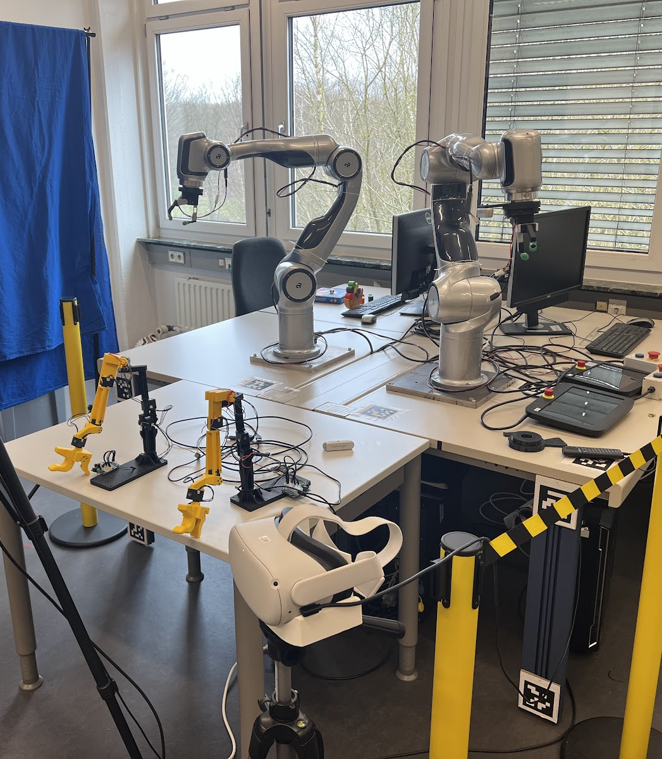
Current Work – pi0-based Policy Learning for Robot Manipulation
• Project: Fine-tuning pi0 policy on
custom ball manipulation dataset
• Dataset collected on diana7 dual-arm
setup with multi-camera ROS system
• Policy trained using openpi (pi0_fast_ball config)
on dual H100 GPUs
• Next step: Execute actions on real robot using
policy server
Notes:
In addition to the contributions in my thesis, I’m currently working on a new project to fine-tune a pi0 policy using a ball manipulation dataset that I collected myself.
The data was recorded with the diana7 dual-arm platform, with three synchronized RealSense cameras and full ROS integration. After preprocessing the data into the Hugging Face lerobot format, I trained the pi0_fast_ball policy using the openpi framework.
The model was trained for 30,000 steps on dual H100 GPUs and is now successfully served as a policy server. The next step will be executing the learned actions on the physical robot. This project shows the potential of combining pre-trained vision-language models with custom robot platforms for real-world manipulation.

Slide 10
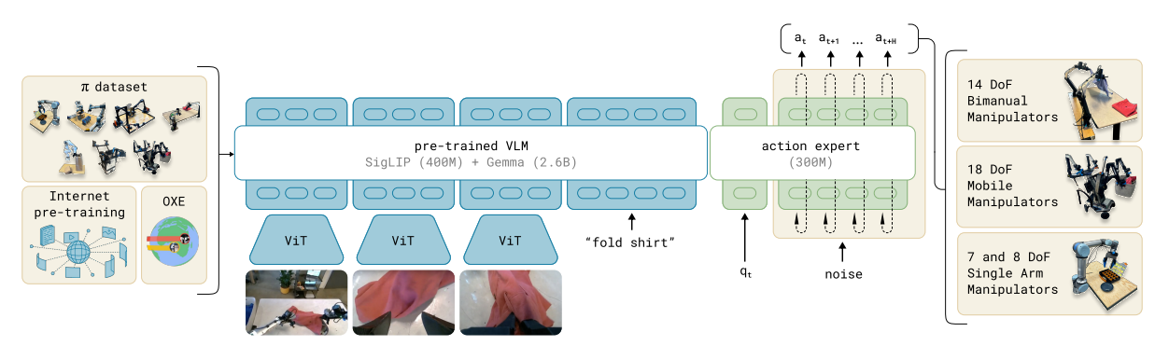
π0
• pi0 is a language-conditioned policy for diverse robot manipulation tasks
• Uses frozen vision encoder + frozen language encoder (CLIP)
• Trains a lightweight transformer-based token policy head
Inputs: Language prompt; One or more visual observations (RGB, segmentation, robot state)
• Outputs: Sequence of tokenized low-level robot actions
Notes:
pi0 is a general-purpose manipulation policy designed to operate across a wide range of robot tasks using language instructions.
The key idea is to freeze powerful pretrained vision and language encoders—such as CLIP—and train only a lightweight transformer-based token policy head.
Given a task prompt, such as “stack the red block on the green one,” and a visual observation, pi0 encodes the scene and predicts a sequence of discrete tokens.
These tokens are interpreted as low-level robot actions.
The design allows for efficient generalization and adaptation: pi0 supports zero-shot prompting for new tasks, while the pi0-FAST variant enables rapid fine-tuning on user-collected demonstrations.
I am currently applying pi0 to tool-use tasks such as pick-and-drop and plan to integrate it with ToolGPT, where ToolGPT provides semantic 6D poses of tool parts, and pi0 generates the corresponding action trajectories.

Slide 11
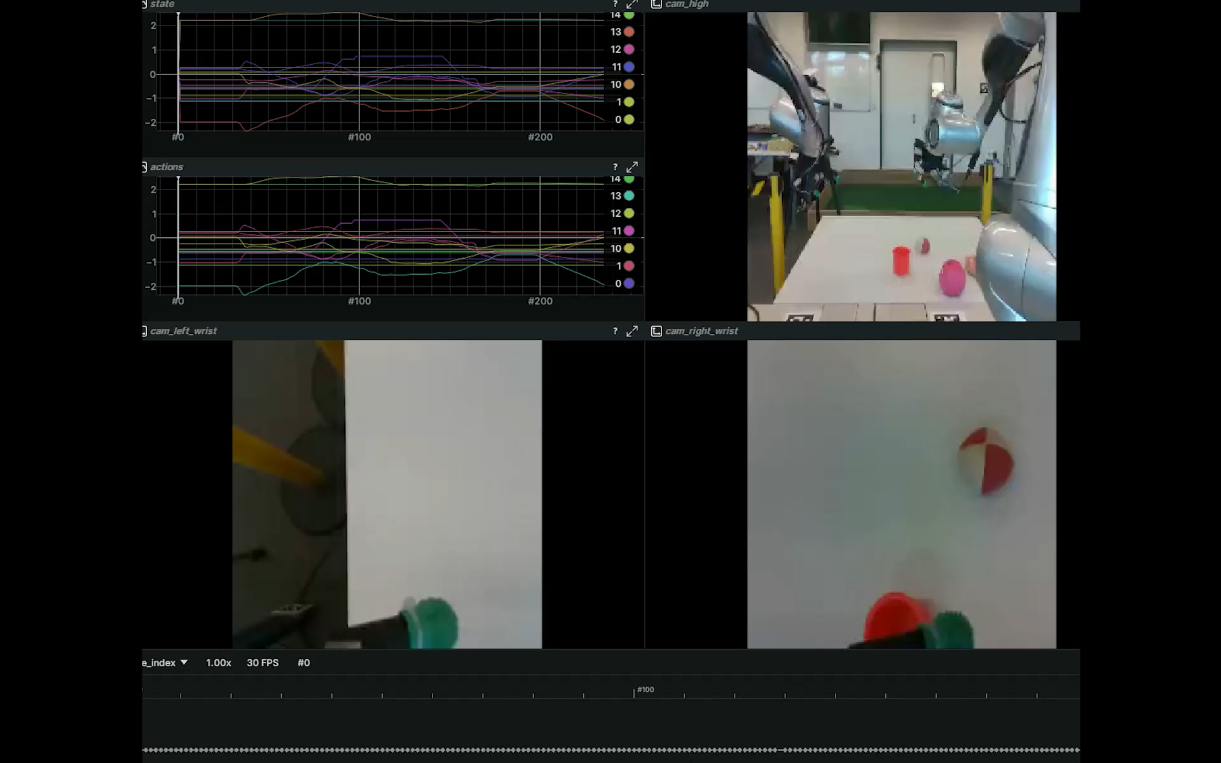
Future work

Slide 12
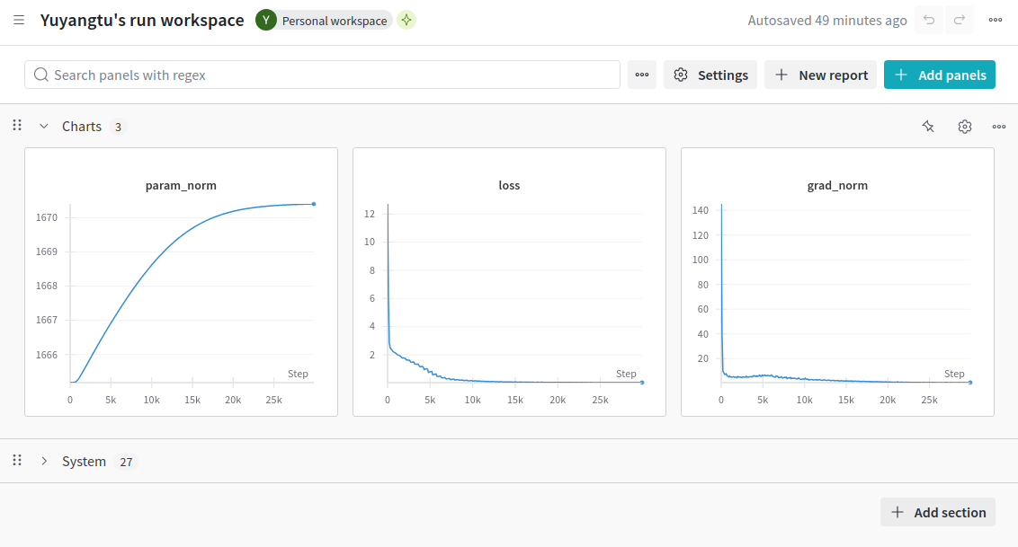
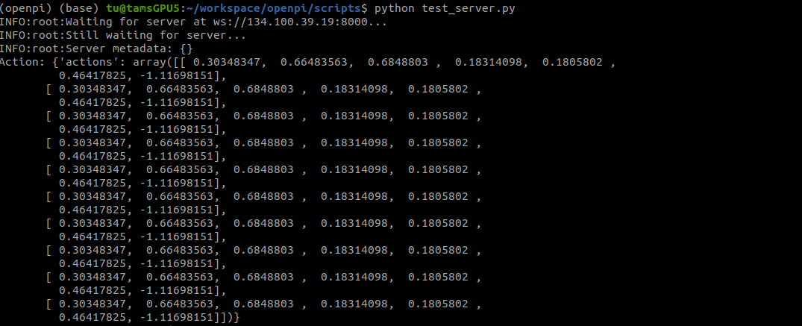
Future work

